Slide 1

CAESURA: Language Models as Multi-Modal Query Planners
Caesura Motivation & Vision
Traditional query planning vs Caesura’s approach
Phases of Caesura’s Query Plannings
Error Handling
Example of CAESURA generating and executing a plan
Challenges, Limitations, & Future Directions
Key Takeaways
Matthias Urban Technical University of Darmstadt
Carsten Binnig Technical University of Darmstadt & DFKI
Presenters :
Demetra Paphitou
Konstantin Krasovitskiy

Slide 2


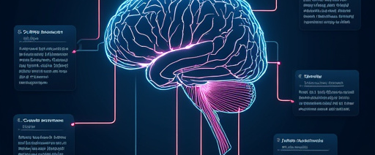
CAESURA Motivation & Vision
Multi-modal Data
Natural Language Queries
Vision
Modern data lakes hold text, images, documents, etc.
Laypeople can query without specific knowledge
Use natural language to query multi-modal data
Notes:
Motivation: New trends that make traditional SQL is very limiting
Trends:
Use of multi-modal data, store and analyze data other than text
Natural Language, allow non experts to do queries
Vision: Natural Language -> SQL for multi data

Slide 3
Overview of Traditional Query Planning
SQL Query parsed into structured format
Applies optimizations, reordering joins, uses indexes
Explore multiple possible plans
Find best route to get data efficiently
Notes:
How traditional query planning works.
Reads SQL Query
Optimize the order of query execution by reordering joins and using indexes
The concept is to create a plan to execute queries
Essentially finds the best way to get data efficiently

Slide 4
Traditional query planning vs Caesura’s approach
 | Traditional Query Planning | CEASURA Query Planning
Language | SQL Language | Natural Language
Supported Data | Structured data | Multi-modal data
Flexibility | Limited to SQL supported operations | Diverse operators
Notes:
See differences between traditional and Caesura.
Language: Needs SQL knowledge / Uses natural language
Supported data: Structured data in table format / Multi-data such images and documents
Flexibility: Limited basic operators / Complex operators such as VisualQA and TextQA for processing unstructured data

Slide 5
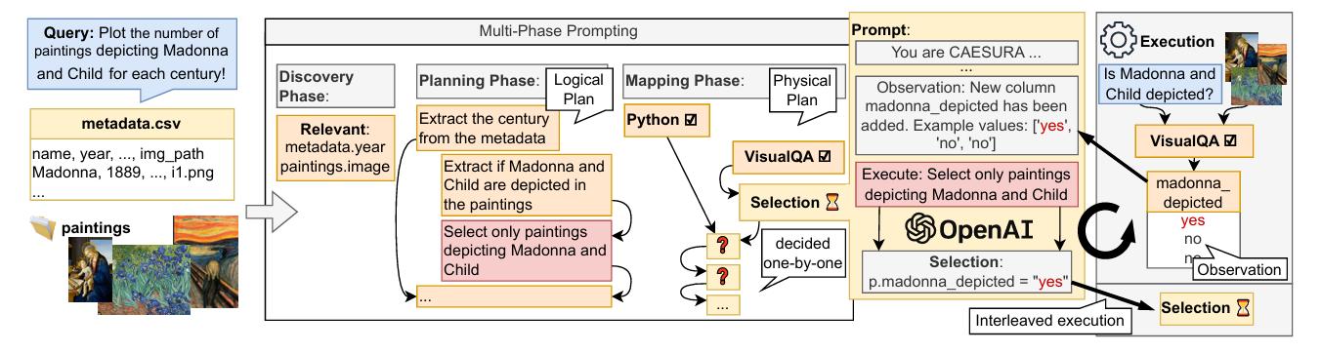
CAESURA Overview - Architecture
Notes:
This is CAESURA’s architecture. First step is to input a natural language prompt-request, that refers to specific dataset.
Then CAESURA has three phases to create a prompt(see next slide).
Afterwards, caesura creates a prompt for ChatGPT to ask for the specific query.
Finally, ChatGPT’s query is executed

Slide 6
Architecture in Three Phases
Discovery Phase
Planning Phase
Mapping Phase
Retreive data and identify which tables or data sources are relevant.
LLM outputs a logical plan in natural language. The logical plan is a prompt containing description of data, capabilities of CAESURA, output format description, and user query.
Prompt describes operators and LLM chooses physical operators for each logical step.
Notes:
Here we can see the phases in more detail
Discovery: Find relevant data based on the request
Planning: Create a plan in natural language containing all the important steps and information
Mapping: Use Plan to describe necessary operators for the LLM to turn into physical operators. The selection is done step by step

Slide 7
Error Handling
Error message is added in the prompt.
Root of error might be unknown reason or from previous step
LLM identifies error and backtracks
This method does not handle incorrect outputs
Notes:
Caesura handles errors in a simple way. Adds the error in the prompt.
Each fix backtracks the process until the result is an executable plan.
However, this does not check for correctness.

Slide 8
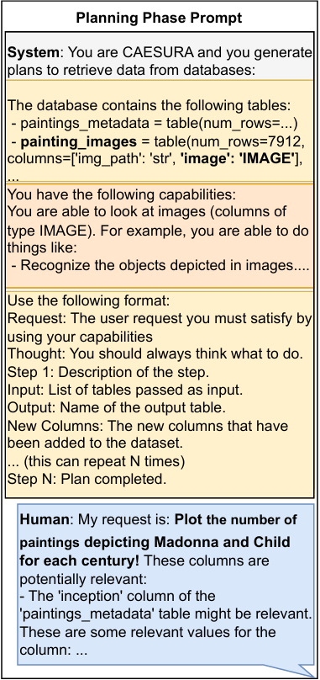
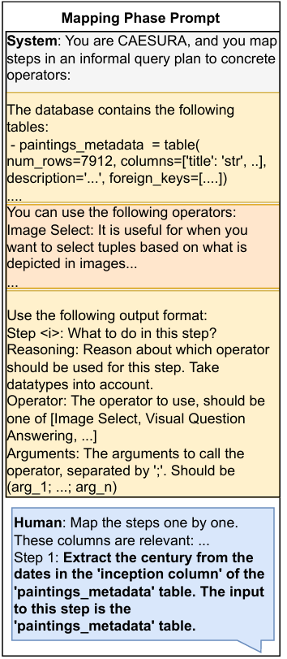
LLM Integration (How are LLMs used ?)
Sample prompt that CAESURA uses in order to make use of an LLM.
It is queried on each step of the planning and mapping phase
Notes:
Explain that CAESURA leverages large language models (e.g., GPT-4) to interpret natural language queries.
Mention that LLMs are used at multiple stages: creating the logical plan, mapping it to physical operators, and even in error handling (to re-prompt or adjust plans).
Emphasize that the LLM “thinks” in human-like terms, producing a natural language blueprint that is later executed by specialized operators.

Slide 9
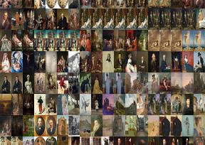
Example of CAESURA generating and executing a plan
User Query:
"Plot the maximum number of swords depicted in the paintings of each century”
Dataset:
paintings_metadata(table): columns = [title, inception_date, img_path] painting_images(table): columns = [img_path, image (IMAGE datatype)]
Goal:
Produce a bar chart: (century vs. count of relevant paintings)
Notes:
Introduce the sample query: “Plot the maximum number of swords depicted in the paintings of each century.”Point out that this example demonstrates CAESURA’s ability to combine different data modalities (tables and images) using a multi-step plan.
Mention that both logical (high-level) and physical (operator-specific) steps are generated by the LLM.

Slide 10
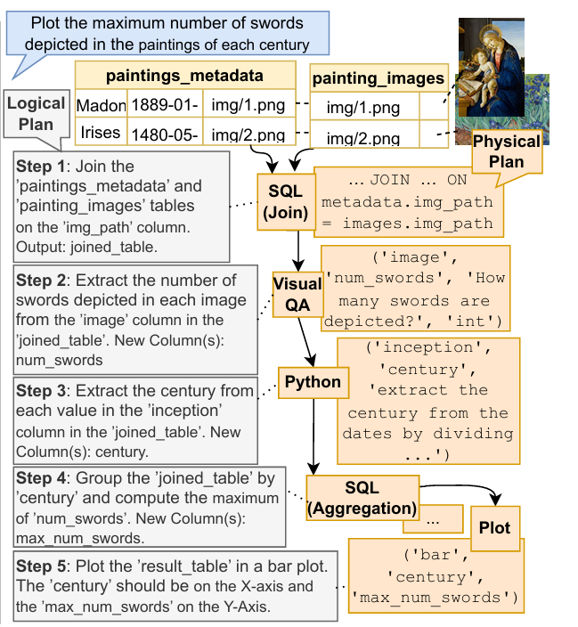
Demonstration (Discovery Phase)
Discovery Phase :
LLM finds that paintings_metadata and painting_images are relevant from the database
Notes:
Explain that in the discovery phase, CAESURA examines available data sources.
Describe how it identifies that both the paintings metadata and the painting images are relevant.
Stress that this phase narrows down which tables and image collections to use, skipping full data retrieval for efficiency.

Slide 11
Demonstration (Logical Plan)
Step 1:
Join paintings_metadata and painting_images on img_path.
Notes:
Detail that the first logical step is to join the paintings metadata with the painting images on the common img_path field.
Explain that this join is critical to ensure that each painting’s metadata is associated with its corresponding image.

Slide 12
Demonstration (Logical Plan)
Step 2 :
Extract the Number of Swords in each image.
Notes:
Explain that the next logical step is to extract the number of swords from each image.
Mention that CAESURA uses a VisualQA operator to “ask” the image model, “How many swords are depicted?”
Note that the output of this step is a new column (e.g., num_swords).

Slide 13
Demonstration (Logical Plan)
Step 3 :
Extract the Century from the inception date.
Notes:
The third logical step involves converting the painting’s inception date into a century.
Explain that this is typically done using a Python UDF that computes century = (year // 100) + 1.
Emphasize that this transformation is key for grouping in the later stage.

Slide 14
Demonstration (Logical Plan)
Step 4 :
Group by Century and Compute MAX of num_swords.
Notes:
Describe that the next step is to group the data by century.
The goal here is to compute the maximum number of swords for each century.
This step summarizes the results, preparing them for visualization.

Slide 15
Demonstration (Logical Plan)
Step 5 :
Plot the final results.
X-axis: century
Y-axis: max_num_swords
Notes:
Explain that the final logical step is to plot the results.
The output should be a bar chart where the x-axis represents the century and the y-axis represents the maximum sword count.
Stress that this makes it easy for users to gain insights from the data.

Slide 16
Demonstration (Physical Plan)
Step 1 :
SELECT … FROM paintings_metadata m
JOIN painting_images i ,ON m.img_path = i.img_path;
Notes:
Transition to the physical plan where each logical step is mapped to specific operations.For step 1, show the SQL join operator in action:sql
Copy
SELECT ... FROM paintings_metadata m JOIN painting_images i ON m.img_path = i.img_path;
Mention that this operator is responsible for combining the two tables based on the matching image path.

Slide 17
Demonstration (Physical Plan)
Step 2 :
Prompt VisualQA:
“How many swords are depicted?”
Returns an integer num_swords for each image.
Notes:
For step 2, explain the mapping of the image processing step.
The system issues a VisualQA prompt: “How many swords are depicted?”
The operator then returns an integer value (num_swords) for each image.
Emphasize that this step bridges the gap between visual data and structured results.

Slide 18
Demonstration (Physical Plan)
Step 3 :
Convert inception to century,
century=(year // 100)+1.
Notes:
For step 3, highlight the Python UDF that transforms the inception date into a century.
Show a simple code snippet (or describe it) that computes the century, ensuring that the data is ready for aggregation.
Note that this transformation is critical for grouping the data correctly.

Slide 19
Demonstration (Physical Plan)
Step 4 :
SELECT century, MAX(num_swords)
AS max_num_swords
FROM joined_table
GROUP BY century;
Notes:
Step 4 maps the grouping operation: using a SQL aggregation operator to compute:sql
SELECT century, MAX(num_swords) AS max_num_swords FROM joined_table GROUP BY century;
Explain that this step summarizes the data to show the maximum number of swords per century.

Slide 20
Demonstration (Physical Plan)
Step 5 :
Bar chart with century on X-axis and max_num_swords on Y-axis.
Notes:
Finally, in step 5, the system generates the final visualization.
Describe that a plotting operator (e.g., using matplotlib or seaborn) creates a bar chart with century on the x-axis and max_num_swords on the y-axis.
Stress that this visual output provides a clear and intuitive insight into the data.

Slide 21
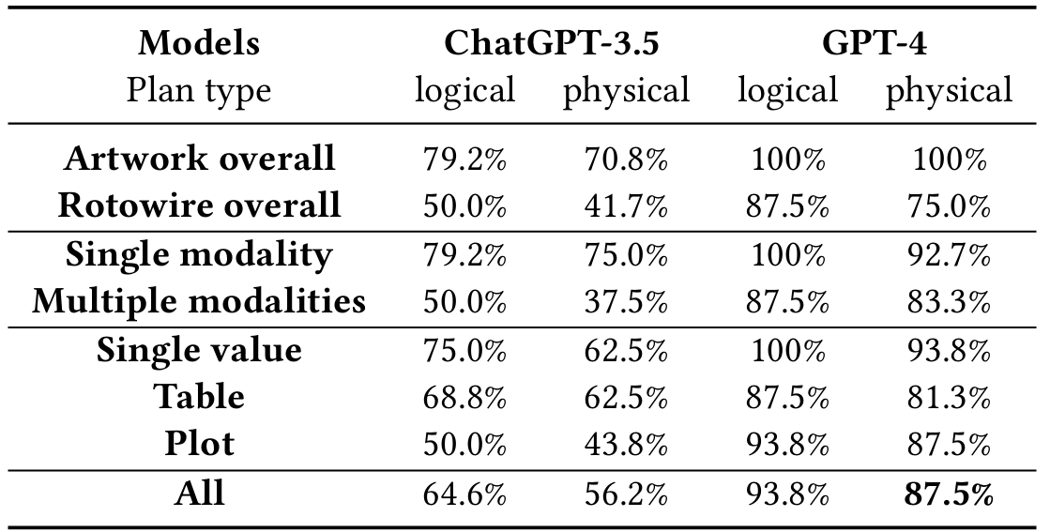
Evaluation Of Query Planning
Experiment Setup:
24 queries per dataset (artwork & rotowire) and discovery phase skipped (assume perfect retrieval)
Query types: 16 single-value, 16 table output, 16 plot output
Half queries require multi-modal data; half use only relational data
Notes:
Results:
GPT-4 outperforms ChatGPT-3.5:
Up to 87.5% correct translation overall
Artwork dataset: 100% correct plans
Rotowire dataset: ~75% correct, indicating room for improvement
Key Insight:
LLM-driven planning shows promise, but further work is needed on plan robustness and optimization

Slide 22
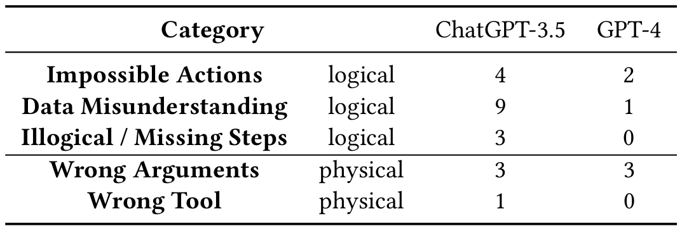
Error Analysis in CAESURA's Query Planning
Logical Phase Errors : Impossible Actions, Data Misunderstanding, Illogical/Missing Steps
Physical Phase Errors : Wrong Arguments, Wrong Tool
GPT-4 shows less logical errors compared to GPT-3.5, in data misunderstanding and missing steps.
The most common error for GPT-4 is wrong input arguments during the mapping phase.
GPT-3.5 often misinterprets data, relying too much on title/genre, causing bad multi-modal plans.
Notes:
Summarize the types of errors encountered:Logical phase errors: impossible actions, data misunderstanding, illogical/missing steps.
Physical phase errors: wrong arguments, wrong tool selection.
Emphasize that GPT-4 shows fewer logical errors than GPT-3.5, but still commonly makes mistakes with input arguments.Note that GPT-3.5 often misinterprets data by relying on title/genre information.

Slide 23
Challenges, Limitations, & Future Directions
Reliability
Plan Optimization
Security & Safety
Further Directions
LLMs sometimes omit steps or reference nonexistent columns.
CAESURA partially mitigates by interleaving execution & repair.
Multi-modal cost estimation is hard (e.g., cost of image recognition). Future: learned cost models for ML-based operators.
Generated code must be sandboxed.
Strictly limit destructive queries. (DELETE , UPDATE)
Fine-tuning to reduce logical errors hallucinations
Integrating symbolic verifiers to ensure plan correctness and interpretability.
Improving scalability without overwhelming the LLM context window.
Notes:
Discuss reliability issues: LLMs sometimes omit steps or reference nonexistent columns.
Talk about plan optimization challenges, especially for multi-modal operators (e.g., estimating cost for image recognition).
Address security and safety concerns: generated code must be sandboxed to avoid destructive operations.Mention future research directions:
Fine-tuning LLMs to reduce logical errors and hallucinations.
Integrating symbolic verifiers for plan correctness.
Improving scalability for large datasets without overloading the LLM context.

Slide 24

Key Takeaways
LLM-Driven Query Planning: CAESURA translates natural language into multi-modal query plans, combining relational operators, machine-generated Python UDFs, and VisualQA operators.
Multi-Modal Operators: It enables querying across different data modalities (tables, images, texts) in a single pipeline.
Plan Executability & Correctness: Ensuring the generated plan is executable and logically sound remains an open challenge.
Plan Optimization: Developing cost models for complex multi-modal operators is non-trivial.
Future Potential: Fine-tuning LLMs, integrating symbolic verification, and learning cost models to improve reliability and efficiency.
Notes:
Recap that CAESURA translates natural language into multi-modal query plans using a combination of relational operators, Python UDFs, and VisualQA.
Emphasize that it enables querying across different data modalities in one seamless pipeline.
Acknowledge that ensuring plan executability, correctness, and optimization are ongoing challenges.
Conclude with the potential of integrating advanced techniques like fine-tuning and symbolic verification to improve future performance.

Slide 25
Thank You!
Questions & Discussion

