Slide 1
Hybrid Querying Over Relational Databases and Large Language Models
Research paper by
Fuheng Zhao,
Divyakant Agrawal,
Amr El Abbadi
Presented by:
Andreas Ioannou
Markos Fikardos

Slide 2
Table of contents
1. Introduction
2. Background and Problem Statement
3. SWAN Contruction
4. Beyond-database query methodologies
5. Evaluation
6.Conclusion

Slide 3
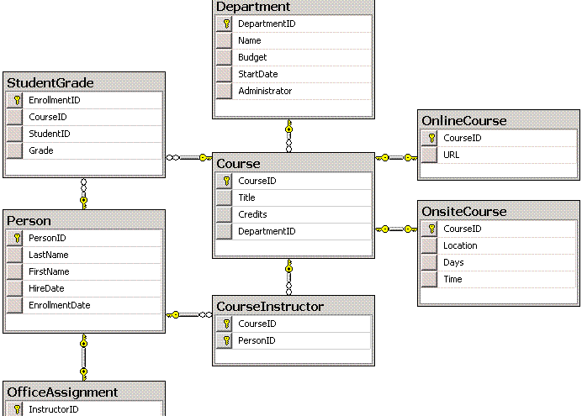
Introduction:
Traditional SQL Databases
Familiar design
Data stored into tables, columns, rows, with keys to connect tables
Pre-defined schema to allow for efficient lookup and storage

Slide 4
Design limitation?
Databases are a representation of real life
An image is built based on stored data
Data that is stored is based on sampling, data exerts

Slide 5


Closed-Domain Assumption
Database can only answer queries that relate to data explicitly stored
Database cannot generate answer based off its knowledge, it simply retrieves data
Highly reliable structure, but rigid and limited when dealing with incomplete or evolving data

Slide 6
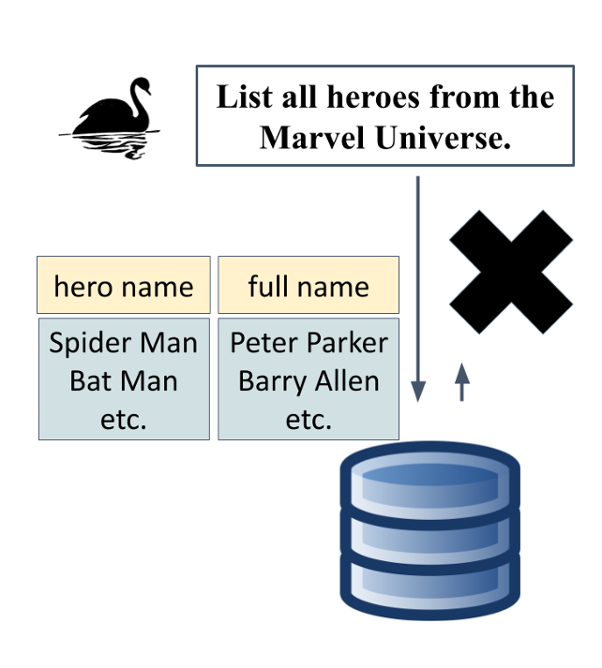
Base example: Superheroes
Database has knowledge of Hero names and their Identities
However, despite their publishers being widely known, the database cannot answer which superhero belongs to which publisher

Slide 7


Beyond database question
Queries that require information missing from the database
Often reference external knowledge, missing attributes, or inferred relationships
Traditional SQL queries fail when required data is not explicitly stored
Require a system that can interpret context and fill in missing details
Solution: Use Large Language Models (LLMs) or external datasets to supplement missing data

Slide 8
How LLMs Enhance Database Queries
Trained on vast datasets → Can infer & generate missing info
Enhance SQL queries → Fill in gaps beyond stored data
Reduce manual updates → Automate beyond-database answers

Slide 9
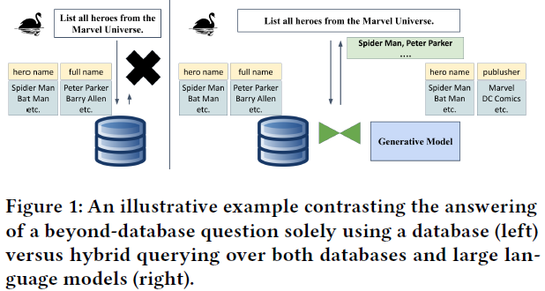
Example
Database schema: superhero(hero_name, full_name)
User wants all Marvel superheroes.
SQL Query: SELECT hero_name, full_name FROM LLM JOIN superhero ON LLM.hero_name = superhero.hero_name WHERE LLM.publisher = “Marvel”
Notes:
1. Simple database
2. User wants all hero names from Marvel Universe this is a Beyond Database Question since database contains relevant or partial information to the request and cannot directly provide the answer.
LLM such as Chat GPT can identify the publisher.
Let’s assume LLMs are a table containing hero_name and publisher.
3. Using this SQL query we can get the answer we want.

Slide 10
Proposals
SWAN Benchmark(Solving beyond-database queries With generative AI aNd relational databases).
HQDL (Hybrid Query Database and LLM)
Notes:
The first hybrid query benchmark.
Swan has 120 beyond database questions and 4 big databases.
A solution for answering beyond database questions

Slide 11

Background and Problem Statement

Slide 12
Large Language Models (LLMs)

Slide 13
Related Work
Crowdsourced query processing systems by CrowdDB, Qurk, Deco and hQuery.
LLMs for declarative prompting and data cleaning tasks such as data imputation where LLMs repair dirty or missing values in data entries.
Recent studies are limited to preliminary cases due to the absence of an evaluation benchmark.
Notes:
… that address the close-world assumption in traditional query processing but the cost of incorporating human input can be significant, impacting both time and resources.
2. Researchers are inspired by the capabilities of LLMs and investigated

Slide 14


SWAN Construction

Slide 15
What is Swan?
Solving beyond-database queries
With generative
AI
aNd relational databases

Slide 16

Why not Bird Benchmark?
Already existing benchmark named BIRD was first proposed for benchmarking Hybrid queries
BIRD Benchmark was not suitable
BIRD focuses on natural language to SQL translation

Slide 17
Bird vs Swan
BIRD evaluates Natural language to database query conversions
SWAN is the first benchmark specifically designed to measure how well LLMs handle incomplete databases and beyond-database questions."

Slide 18
Schema curation for evaluation
For quality evaluation of their Hybrid query systems:
  They chose 4 of 12 preexisting database from Bird benchmark
  More accurate that creating fake test cases
  Replicated fake test cases by removing select columns from the 4 DBs
      European Football
      Formula One
      California Schools
      Superheroes

Slide 19

Main challenge: Open ended or Structural retrieval

Slide 20
Free Form Response and Value Selection
Requires LLMs to generate data when some context is provided.
In California Schools Database:
  Tables contained both the school's name and the school's url.
  Url column is removed.
  LLMs must generate a short form of urls.
Chooses data from a predefined list.
In Superhero Database:
  Publisher_id field is removed from superhero table.
  Publisher table is removed.
  Unique values for publisher_names are kept.
  LLMs provide a list with all publisher's names.
  Appropriate publisher for each superhero is selected.
Notes:
The school url is often similar to school name and often ends with edu

Slide 21
Keys for Tables from LLMs
Foreign key column is linked to the primary key column in another table.
In LLMs integers do not provide any meaningful insights to generate useful data values.
Foreign key references a unique key in the foreign table.
Databases are designed to include meaningful foreign key for data generated by LLMs.
Example: Combination of superhero_name and full_name serves as the key to find publisher information in superhero database.
Notes:
1. In Relational Databases foreign key column is an integer linked to the primary key column in another table.
3. On SQL standards, foreign key must reference a unique key in the foreign table.

Slide 22
Beyond Database Questions
30 beyond database questions per SWAN database.
  A hybrid SQL query to join the tables in a relational database with the tables generated by LLMs.
  A hybrid SQL query to directly invoke LLM calls based on BlendSQL functions.
  A gold SQL query from Bird, that the expected answer is the execution results of the gold SQL query on the original Bird databases.

Slide 23
4. Answering Beyond-database questions
HQDL
Hybrid Query UDF

Slide 24
HQDL
Hybrid Query Database & LLM
Preliminary solution for Beyond-Database questions
Based on Schema Expansion
Database changes based on query
Benchmarked with SWAN, using x-shot tests

Slide 25
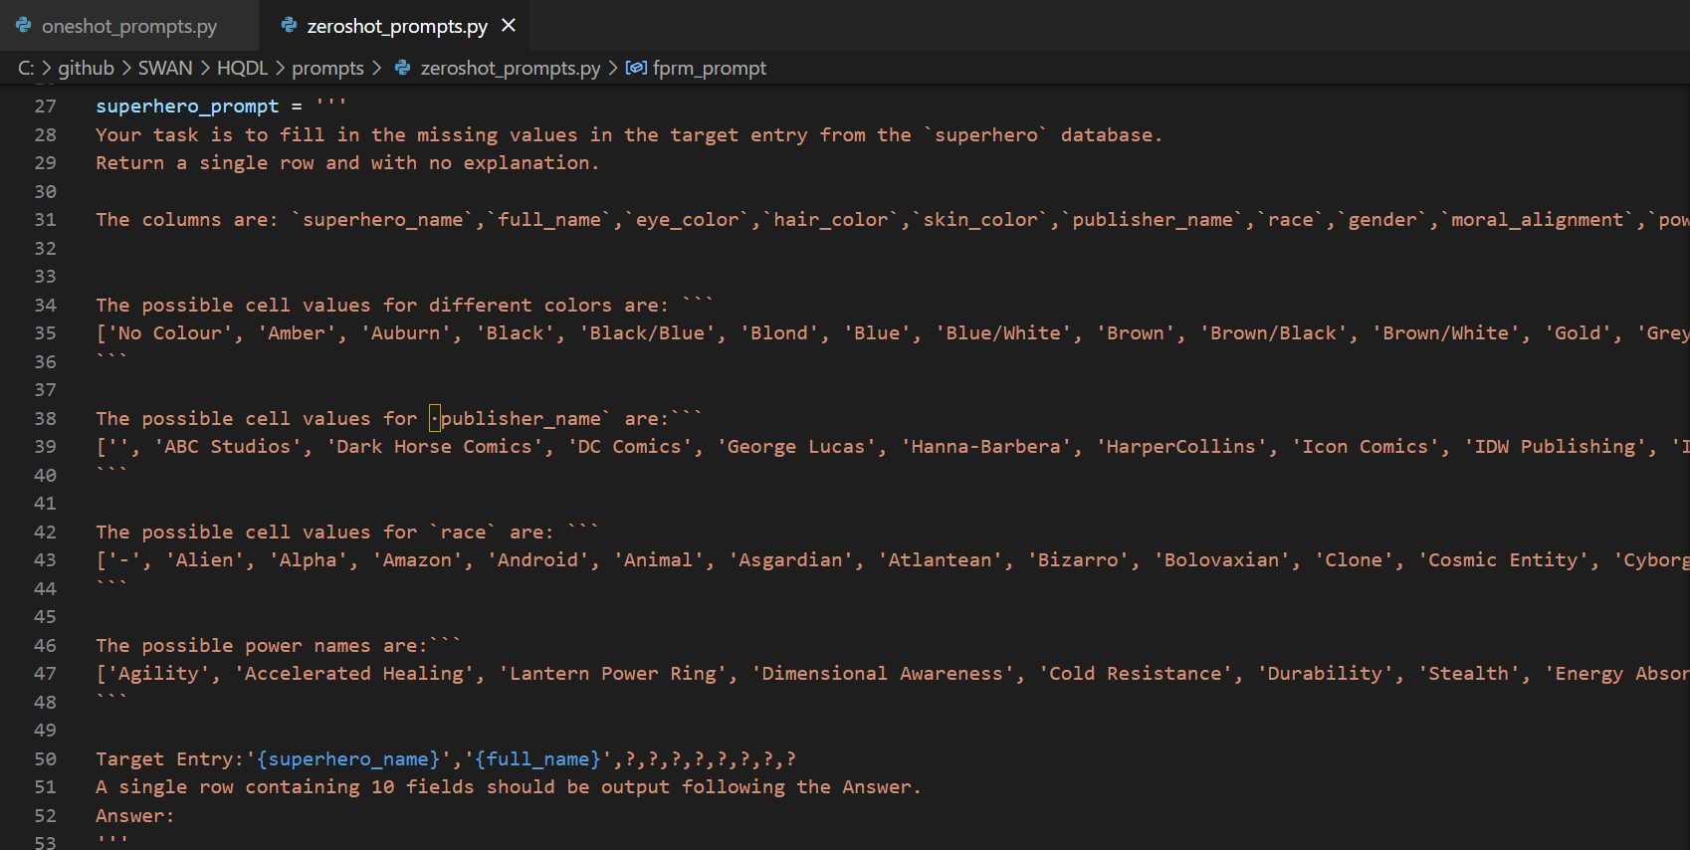

Slide 26
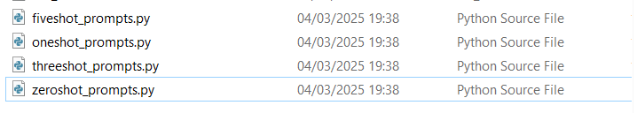

Slide 27
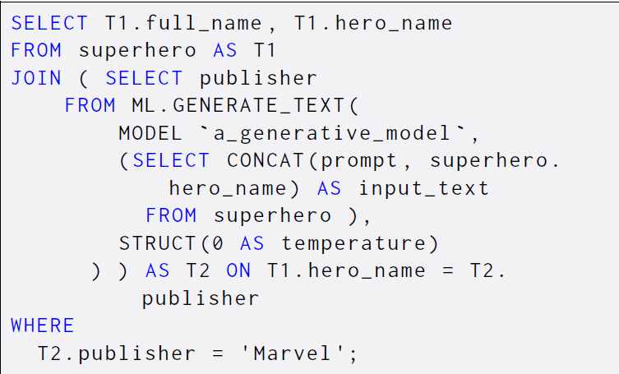
Hybrid Queries UDFs
Notes:
The industry started to integrate LLM calls directly into SQL syntax through user defined functions like DucksDB and Google BigQuery
This is an example to find all hero names from Marvel universe withing the database using Google BigQuery

Slide 28
Hybrid Queries UDFs
More control for the database to:
  Optimize the query.
  Build materialized views.
  Reduce the amount of data generated by LLMs.
All four databases utilize SQLite, so we can directly use BlendSQL.
In SWAN 120 hybrid queries are provided using the BlendSQL syntax
Notes:
Hybrid querying through UDFs offer:
3. … and this allows SWAN to evaluate current systems in querying both relational databases and LLMs.

Slide 29
Optimizations Opportunities
Build vector index on the database values or rows and fetch the relevant information based on embedding similarity
Develop a principled declarative prompt engineering toolkit.
Query Optimization and Caching.
Notes:
To improve the solutions from the HQDL and Hybrid Query UDFs we need select the relevant attributes from a relational database by :
The prompts and static examples are handcrafted, and it would be more convenient if they were automated based on the specific context and query requirements by
To reduce the cost and increase the throughput in order to make hybrid queries more accessible and efficient we need:

Slide 30

Evaluation Metrics
Execution Accuracy (EX)
Data Factuality
Token Cost

Slide 31
Experiment Configurations
Evaluation of HQDL and Hybrid Query UDFs on several OpenAI models via OpenAI api calls.
Temperature is set to 0.
Few Shots:
  Static examples randomly selected from the original database.
  For HQDL, they are organized as static rows.
  For Hybrid Query UDFs, they are organized as a natural language question, an example database key and the answer to the natural language question on the example database key.

Slide 32
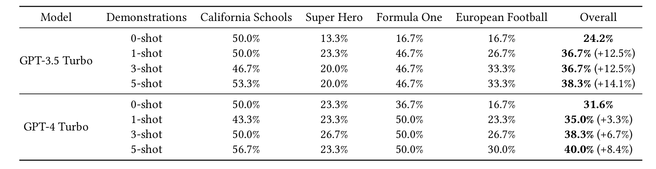
HQDL Results

Slide 33
Points worth mentioning
One of the biggest challenges is in regards to Zero-Shot prompting
Difficult to ensure consistent output format when no sample is provided
Significantly impact data extraction
LLM would sometimes not adhere to prompt and generate a wrong number of data samples

Slide 34
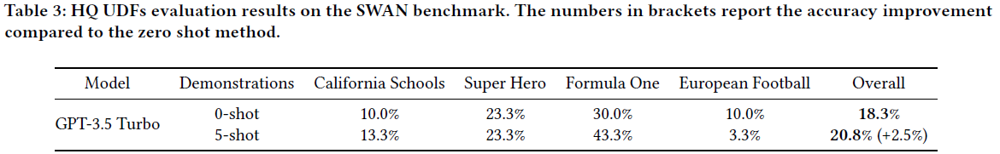
Hybrid Queries UDFs Results
Execution accuracy for 0-shot and 5-shot is lower compared to HQDL's results.
In HQDL, each LLM call generates a single row.
Blend SQL uses a default batch size of 5
  Each request combines five keys into a list, prompting the LLM to return a list of five data entries corresponding to the five keys.
Batching reduced the number of LLM calls but increased the potential for errors cause of the processing of multiple entries in a single call.

Slide 35
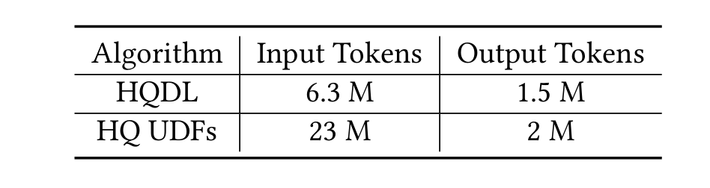
Evaluation Cost
"Token usage" as metric of Evaluation Cost
Researches expected HQ UDFs to be cheaper, however HQDL's caching saves a lot of tokens in the long run as it avoid repeated generation of already requested data

Slide 36
Conclusion and Future Work
There are many opportunities to improve the execution accuracy and increase the overall efficiency.
There are many opportunities to optimize the pipeline for executing hybrid queries, increasing throughput and lowering monetary cost.
In future work the process of answering beyond – database questions should be fully automated.
Notes:
The evaluation shows that

Slide 37
Thank you for listening

