Slide 1
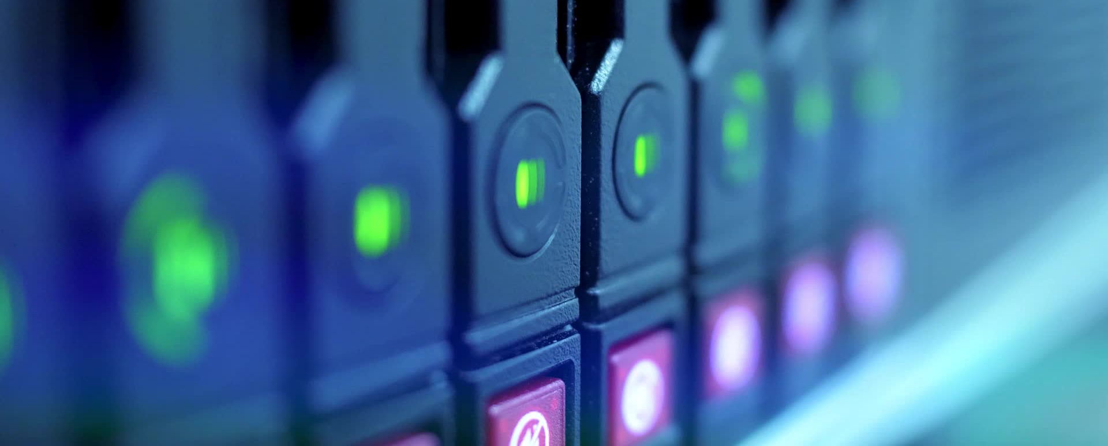
A Case for Ecological Efficiency in Database Server Lifecycles
Alba Sánchez
Sergio Almodóvar

Slide 2

What is the main problem?
Companies frequently upgrade servers to improve performance and energy efficiency, but this has a significant environmental impact.
However, manufacturing new servers has a significant carbon footprint due to material extraction, production, and transportation.
Manufacturing a single server generates as much CO₂ as driving a car for several years.

Slide 3
CPU Performance Evolution Over the Last Decade
CPU evolution has focused more on core count and memory bandwidth than raw clock speed.
Clock speeds have remained stagnant (~2.0–2.5 GHz) due to thermal and power limitations.
Higher core counts enable better parallel execution for modern workloads.
PCIe bandwidth has increased, allowing faster SSD and GPU communication.

Slide 4
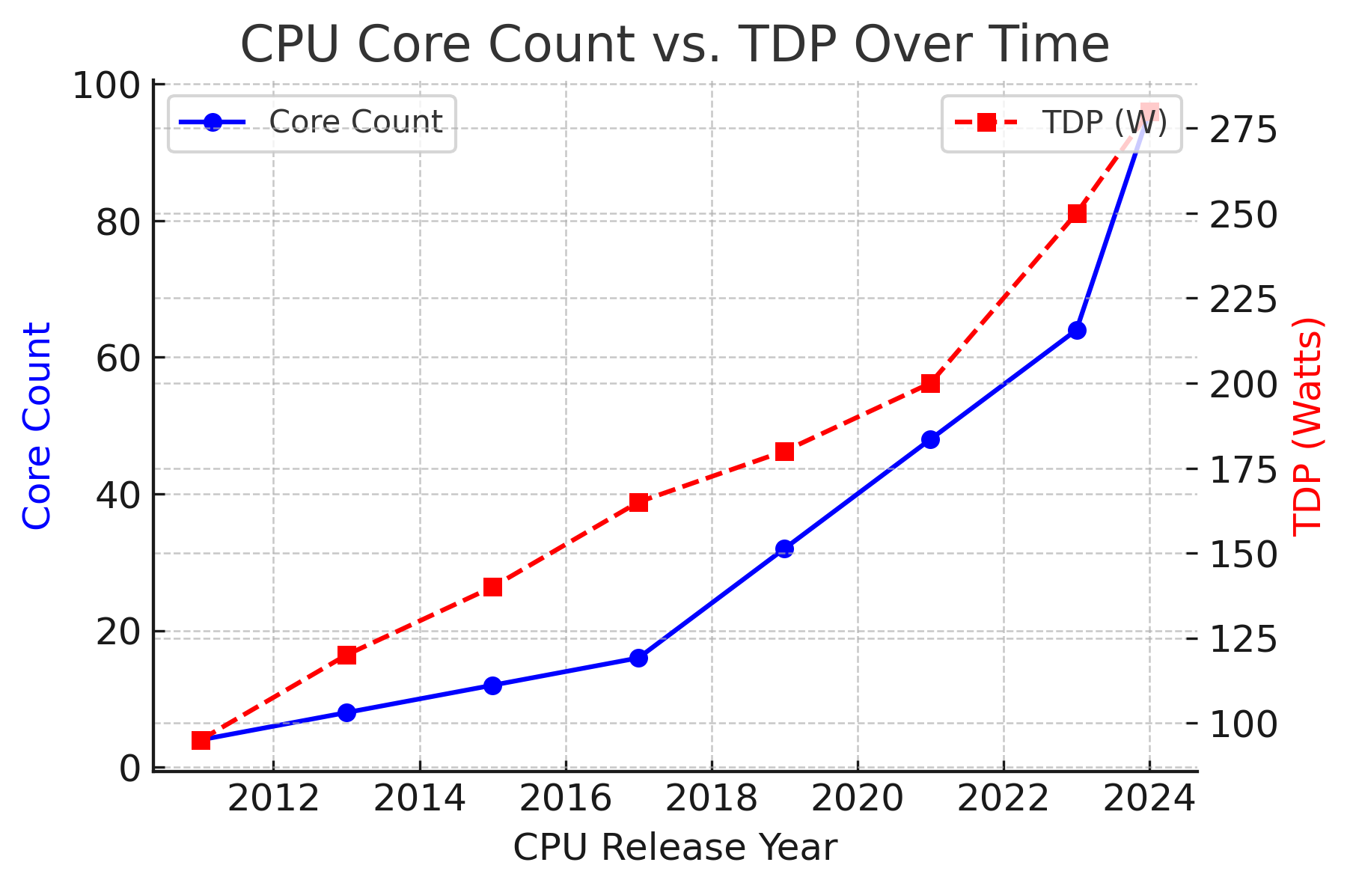
CPU Core Count vs. Power Consumption (TDP)
Core counts have increased dramatically from 4 cores (2011) to 96 cores (2024).
Total power consumption (TDP) has increased, but TDP per core has decreased, meaning CPUs today are more power-efficient per core than before.

Slide 5
The Shift Toward Specialized Hardware
CPUs are no longer the only processing units in a system.
More workloads are offloaded to GPUs, TPUs, and accelerators.
PCIe lanes have increased to support these external processors.
Energy efficiency per core is improving, even as total TDP increases.

Slide 6
How has CPU efficiency evolved in database workloads?
Has increasing core counts truly improved performance
Performance per Core (SPECspeed) – Moderate Improvement
This is single-threaded performance, which has only slightly improved due to limitations in CPU frequency scaling.
Multi-Thread Performance (SPECrate) – Significant Boost
This is multi-core performance, which has increased significantly as CPUs have more cores.
Modern CPUs can handle more database queries at the same time, improving overall performance
Energy Efficiency (Performance per TDP) – Slowed Down
CPUs have become more energy-efficient, but the rate of improvement slowed down after 2016. → This is due to physical limitations in semiconductor technology

Slide 7
How CPUs Impact Database Workloads
Traditional CPU benchmarks (SPECrate) do not reflect database workloads.
Database query performance (TPC-H) improves at a slower rate.
Sorting algorithms are particularly difficult to parallelize, limiting gains.

Slide 8
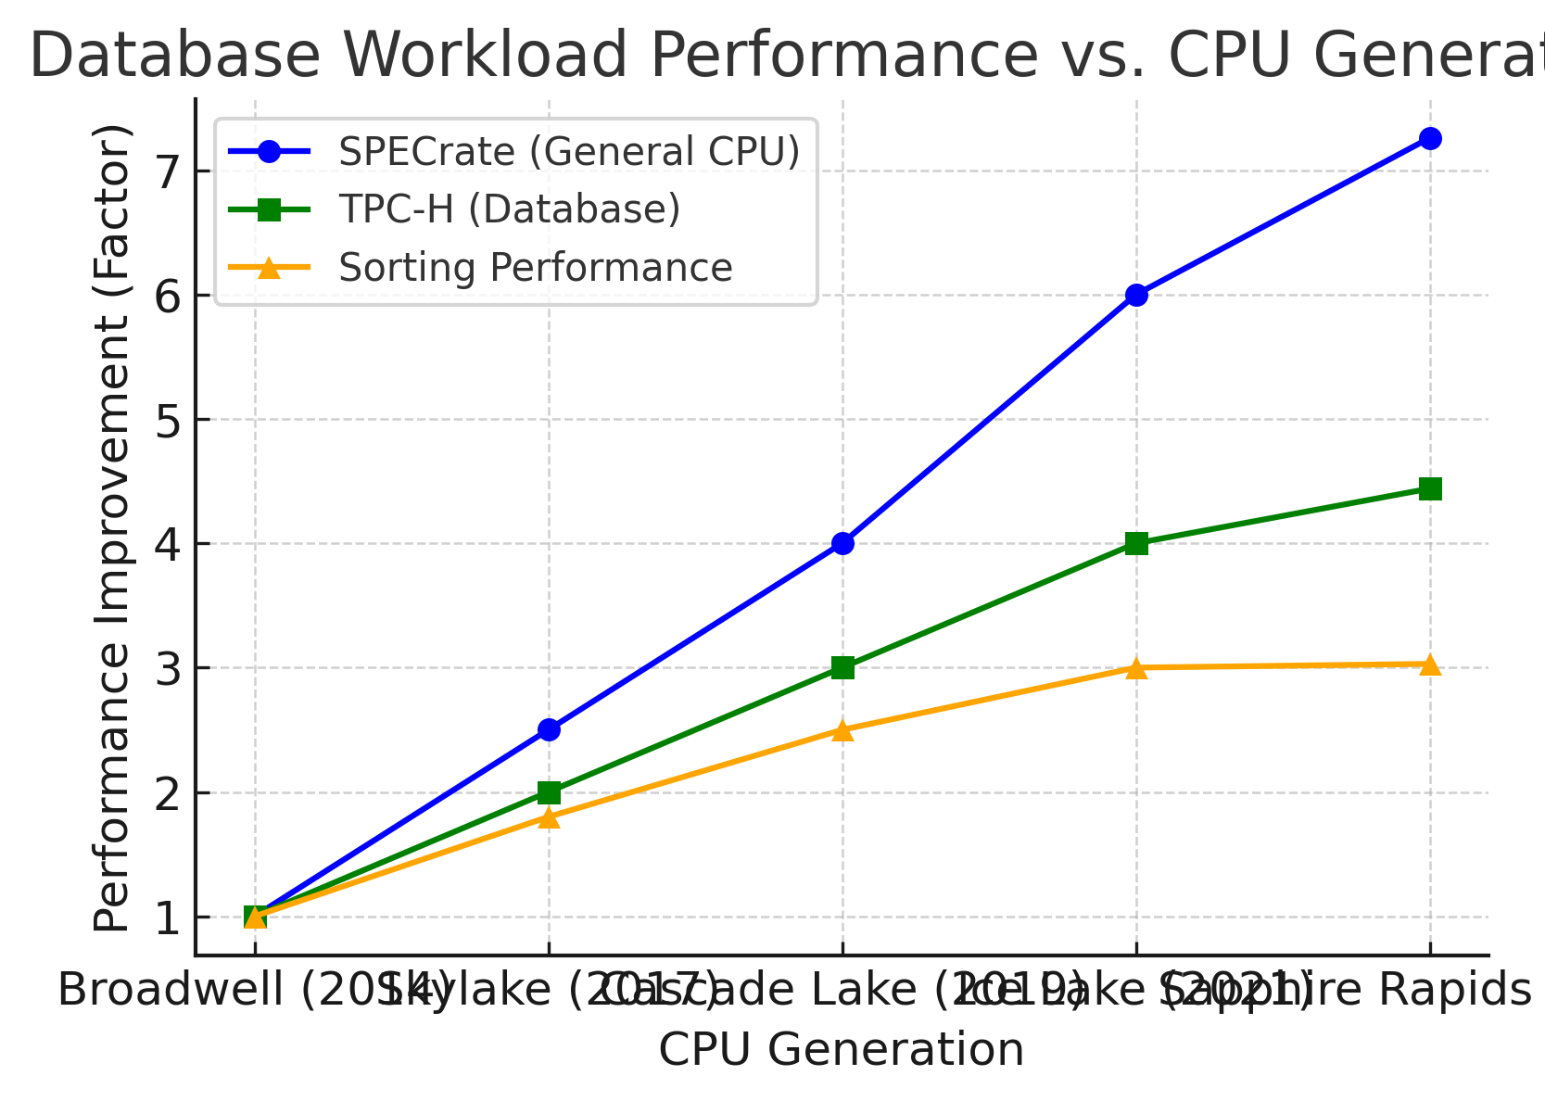
CPU Performance in Database Workloads
Database workloads rely heavily on memory performance, not just CPU speed.
  SPECrate grows the fastest (benefits from new CPUs).
  TPC-H grows slower.
  Sorting grows the slowest due to limitations of memory and storage speeds.

Slide 9
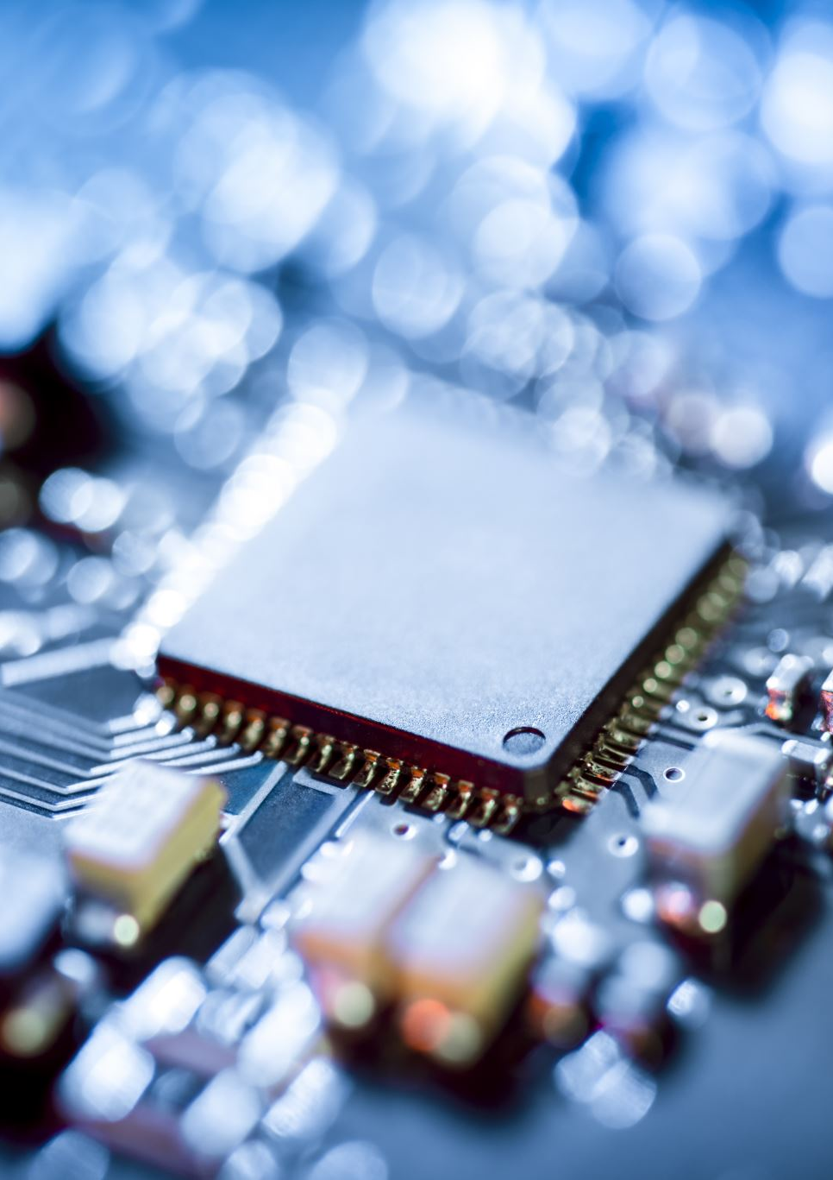
Energy Efficiency Challenges in Modern CPUs
Performance per watt is improving slower than expected.
Older Broadwell CPUs (2016) were sometimes more efficient than newer models.
High TDP CPUs (e.g., 350W Sapphire Rapids) struggle with efficiency.

Slide 10
What is Hardware Lifecycle Efficiency?
Hardware lifecycle efficiency is the evaluation of when replacing a server is ecologically justified, considering its total energy consumption and carbon footprint over its lifespan.
Newer server
  → Less power consumption
  → High carbon print (Manufacturing and transportation.
  → Low enviromental Impact
Old Server
  → Less power consumption
  → High carbon print (Manufacturing and transportation.
  → Low enviromental Impact

Slide 11
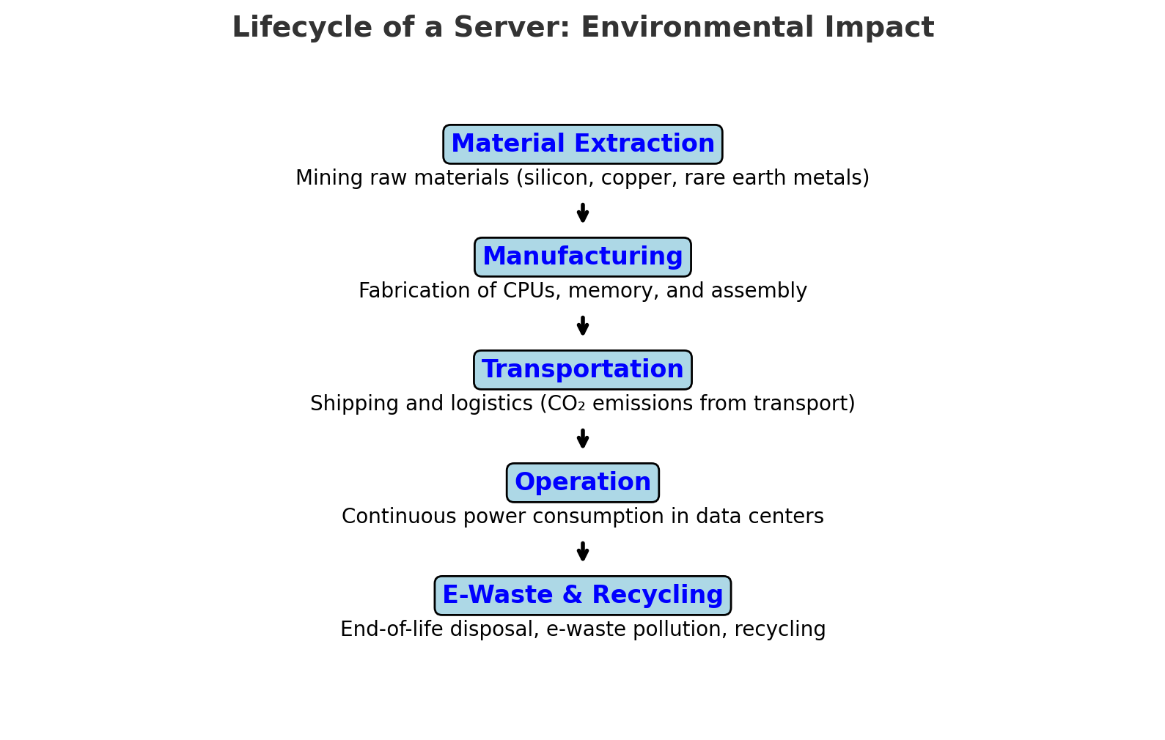
The Lifecycle of a Server
Manufacturing a server produces as much CO₂ as running it for years.
Discarded servers contain toxic materials.
New servers always saves energy? Not always.
Each stage contributes to the server´s overall carbon footprint

Slide 12

How do we measure a server’s total CO₂ footprint?
Procurement Phase – Footprint impacted by the mining of materials and manufacturing processes.
Operation Phase – Footprint impacted by energy consumption.
A server’s carbon footprint consists of emissions from the manufacturing of its hardware components (ECF) and carbon emissions from its operation (OCF) until the end of its life (EOL)

Slide 13
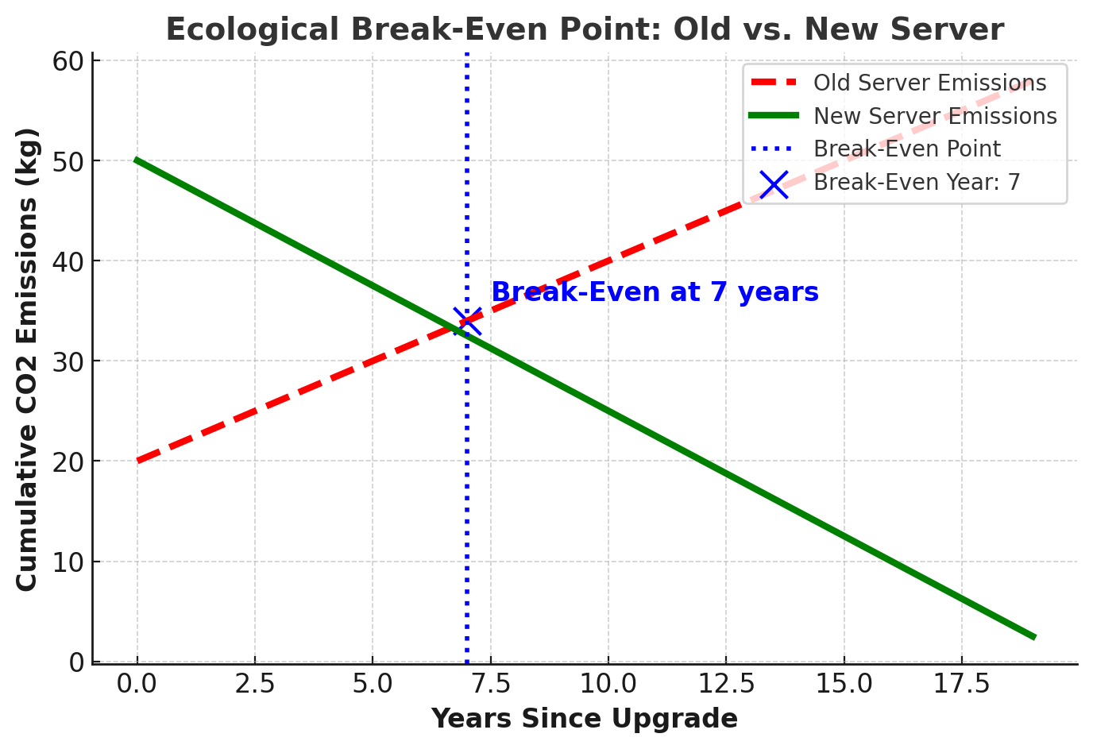
When should a company replace a server? Should they upgrade as soon as a new model is available?
If break-even happens quickly (e.g., 1.7 years in Germany), upgrading is good. If it takes too long (e.g., 17 years in Sweden), keeping the old server is greener.

Slide 14
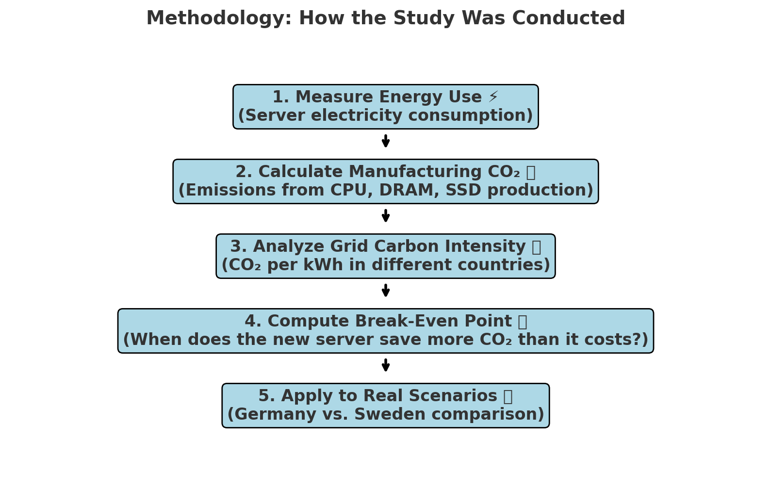
How did the researchers determine whether upgrading was environmentally beneficial?
The study combined energy data, CO₂ calculations, and country-specific analysis to determine if upgrading a server is environmentally efficient.

Slide 15
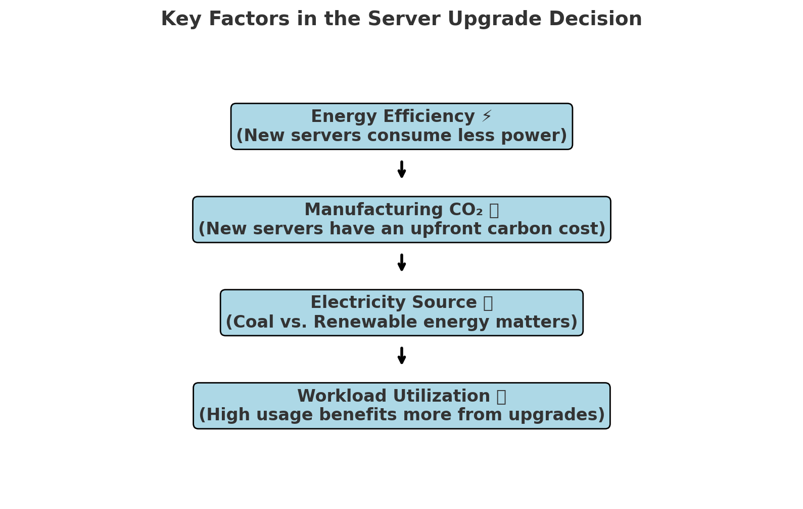
When should a company replace a server? What factors should they consider?
When deciding whether to keep or upgrade a server, companies must weigh energy efficiency against manufacturing emissions.
The goal is to minimize total CO₂ emissions over the server’s lifespan.
  Energy Efficiency
  Manufacturing Carbon Footprint
  Electricity Source
  Workload Utilization

Slide 16
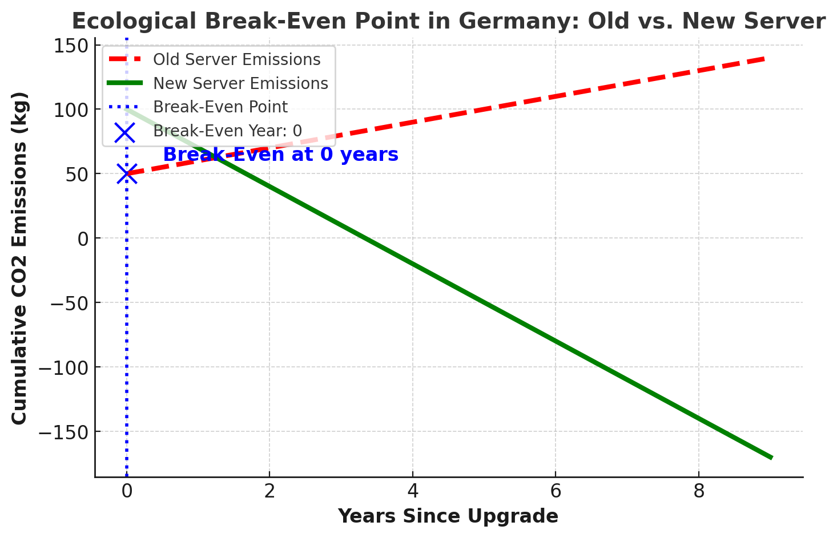
Should companies in Germany upgrade their servers for environmental benefits?
Germany’s electricity grid relies on fossil fuels (coal, gas), leading to high carbon intensity
After 1.7 years, the new server’s energy savings offset its manufacturing emissions.
In Germany, upgrading is environmentally beneficial if the server will be used for at least 2 years.

Slide 17
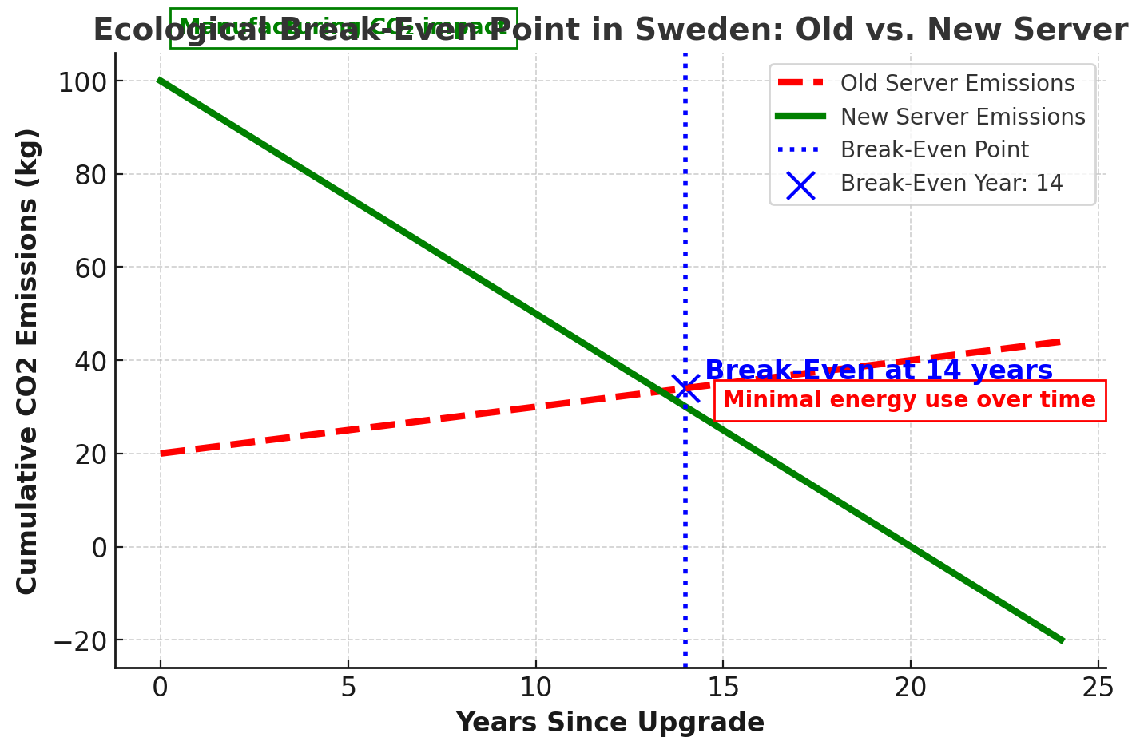
Should companies in Sweden upgrade their servers for environmental benefits?
Sweden’s electricity grid relies on renewable energy (hydro, nuclear, wind), leading to low carbon intensity.
After 17 years, the new server’s energy savings offset its manufacturing emissions.
In Sweden, keeping the old server is environmentally beneficial because the operational emissions are already low.

Slide 18
Does upgrading always reduce emissions? The answer depends on where the server is located
Key Differences Between Germany and Sweden
Germany → High-carbon electricity (344g CO₂/kWh).
Sweden → Low-carbon electricity (25g CO₂/kWh).
Result → Upgrading makes sense in Germany, but not in Sweden.
Break-Even Time for Each Country
Germany → 1.7 years (upgrading quickly leads to lower CO₂ emissions).
Sweden → 17 years (keeping the old server is better due to clean energy).
Conclusion: The Importance of Local Energy Grid
In countries with high-carbon electricity (Germany), replacing servers quickly reduces emissions.
In countries with clean energy (Sweden), the operational emissions of old servers are already low, so extending their lifespan is better.
The decision to upgrade should consider both energy efficiency and electricity grid CO₂ intensity.

Slide 19
Key Conclusions
What did we learn from this analysis?
Upgrading servers is not always environmentally beneficial. The decision depends on:
Energy efficiency of the new server.
Carbon footprint of manufacturing.
Electricity source (clean vs. fossil fuels).
The Ecological Break-Even Point determines if an upgrade is justified.
Companies should evaluate their electricity grid and workloads before upgrading.
Longer hardware lifespans can be more sustainable than frequent upgrades.
Policies should be flexible, region-specific, and consider carbon intensity.

Slide 20
The Environmental Impact of Hardware Upgrades in Databases
Frequent server upgrades do not significantly improve database performance.
They lead to high carbon emissions due to manufacturing impacts.
Focus should shift to software optimizations that extend hardware lifespan.

Slide 21
Why Frequent Hardware Upgrades Are Problematic?
Minimal performance gains for typical database workloads.
High manufacturing carbon footprint.
Short product lifecycles recommended by vendors (4–6 years), but real break-even points are often much longer​

Slide 22
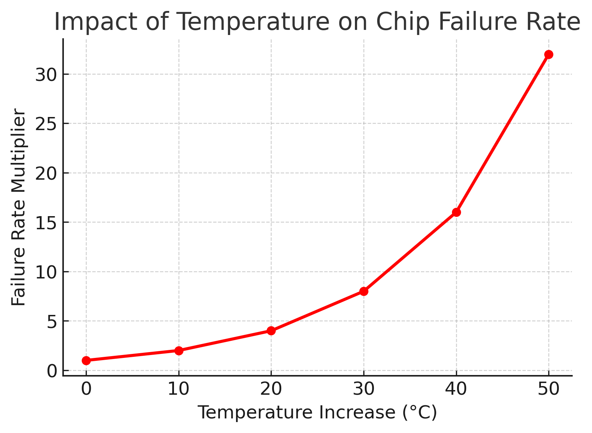
The Role of Temperature in Server Longevity
High temperatures degrade CPUs faster.
Keeping temperatures low extends hardware lifespan.
For every 10°C increase, chip failure rate doubles.
Solution:
Software-based thermal management to control heat-intensive processes.
Better cooling methods for servers.

Slide 23
SSDs and DRAM – The Hidden Longevity Issues
Problems:
SSDs wear out due to excessive writes.
DRAM cells degrade over time, reducing performance.
Solutions:
Smart write buffer caches to reduce SSD wear.
New research on DRAM aging to improve memory management.

Slide 24
Repair or Replace? The Case for Modular Hardware
European Right to Repair policy encourages:
Repairing hardware instead of replacing.
Modular SSDs & DRAM for easy upgrades.
Impact
Extending hardware lifespan reduces environmental impact.

Slide 25
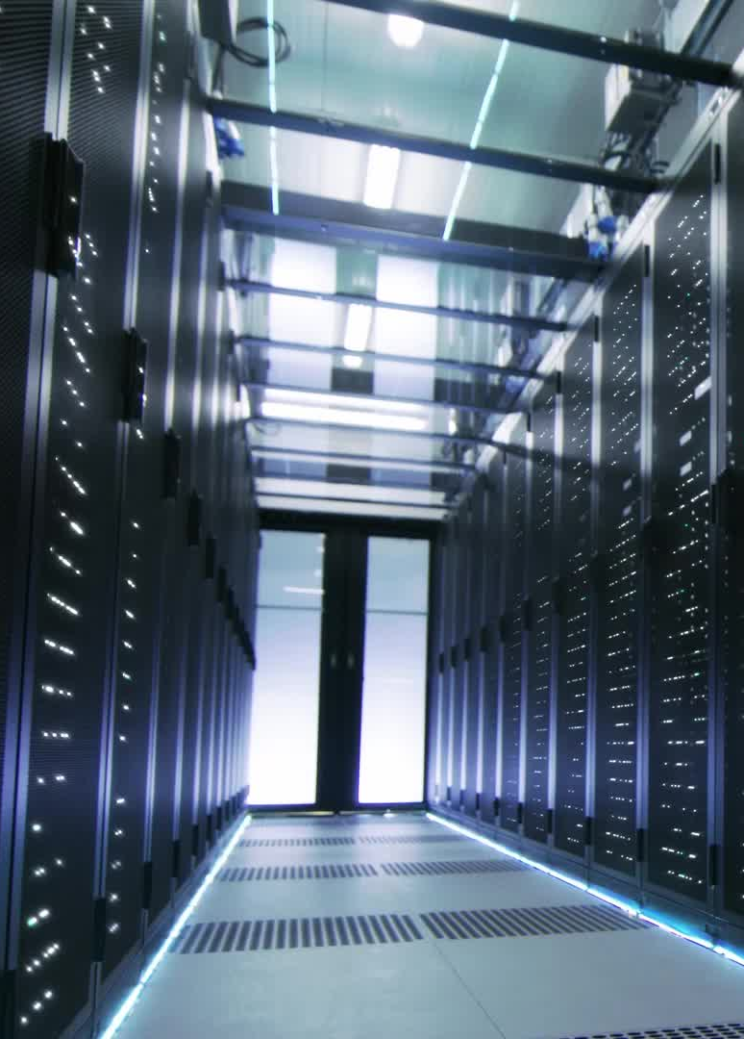
The AI Boom & Hardware Consumption
AI workloads increase demand for new hardware, pushing frequent upgrades.
Large companies are missing carbon reduction targets due to AI growth.
Solution:
Databases should prioritize efficiency instead of hardware expansion.

Slide 26
How Do We Measure Database Efficiency?
Current benchmarks focus on:
Transactions per second (TPS) for transactional databases.
Query execution time for analytical workloads.
Problem:
These metrics ignore sustainability & energy efficiency.

Slide 27
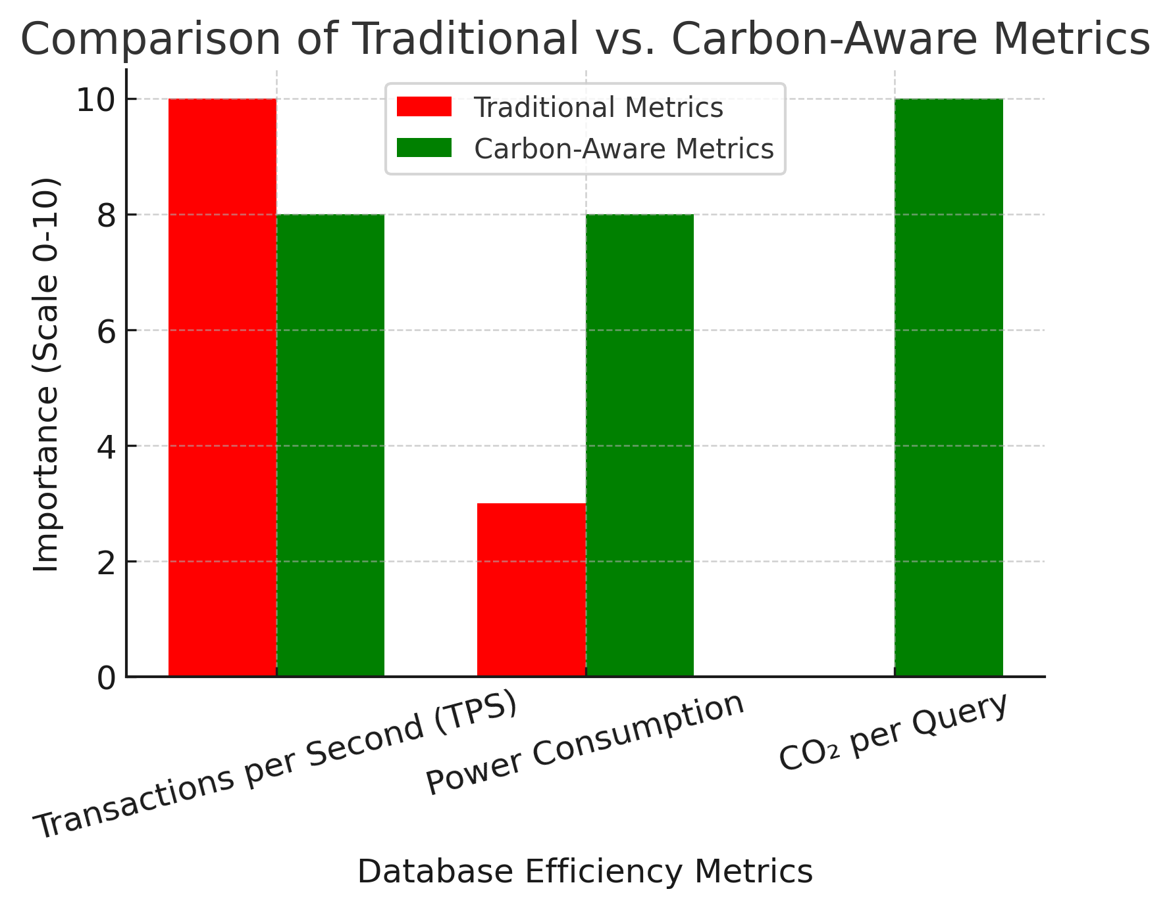
Why Traditional Benchmarks Are Incomplete?
Issues with Current Metrics:
  Traditional benchmarks ignore CO₂ impact.
  Measuring carbon footprint per transaction is necessary.
Proposed Improvement:
  Introduce a carbon-aware database metric.

Slide 28
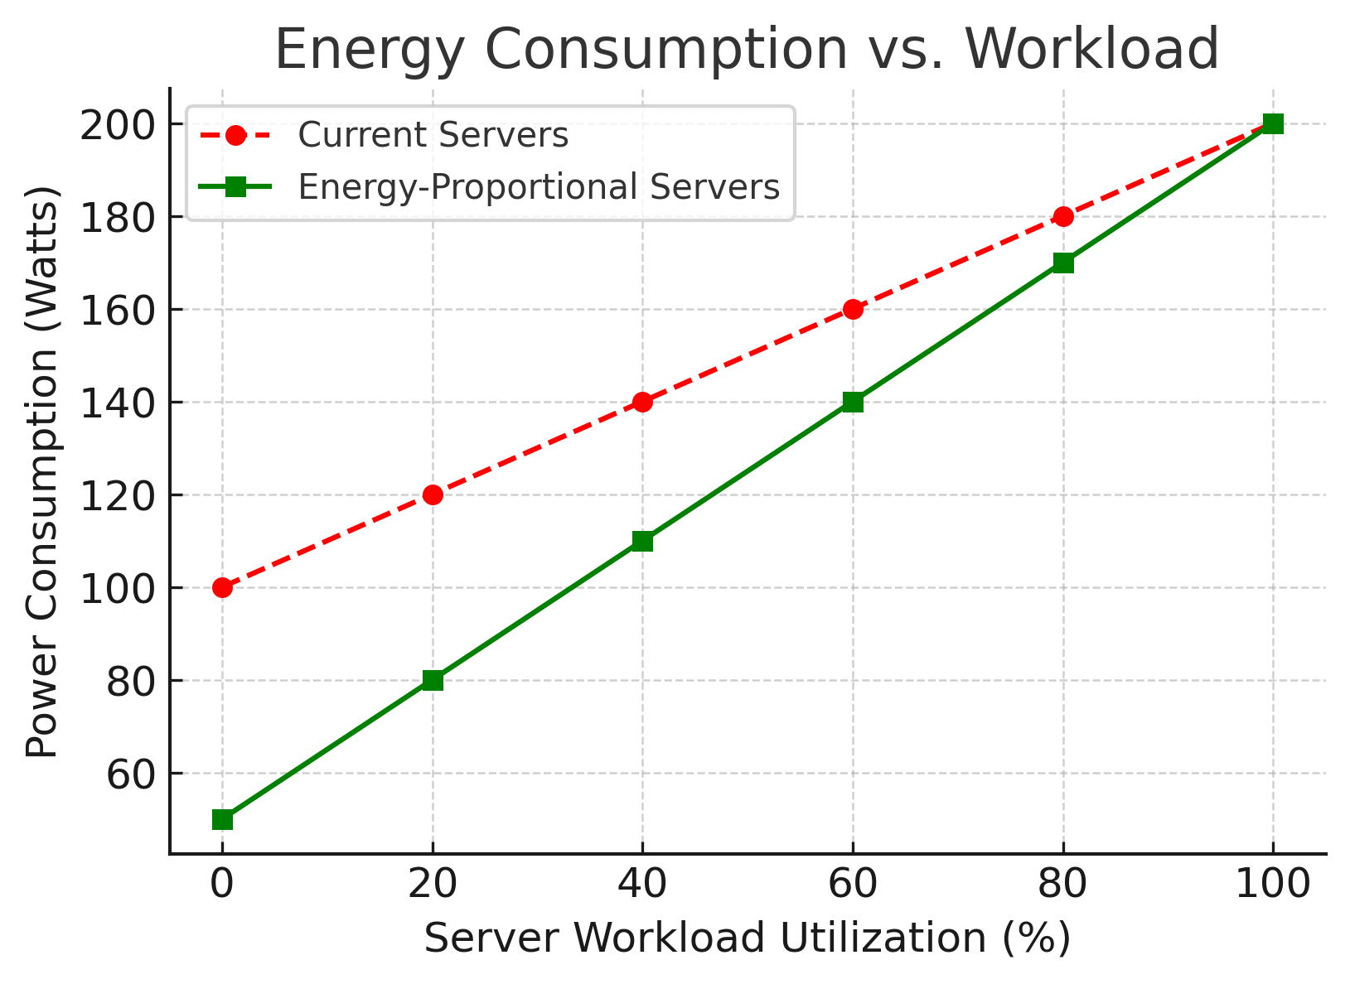
Energy-Proportional Computing – The Future of Efficiency
Current servers consume excessive power even at low utilization.
Energy-Proportional Computing ensures power usage scales with workload.
Solution: Design servers to dynamically adjust power use.

Slide 29
Previous Studies on Carbon Footprint and Hardware
Measuring carbon footprints of hardware.
General-purpose vs. specialized hardware for databases.
Database performance improvements vs. Moore’s Law.

Slide 30
Understanding Carbon Footprint in IT Infrastructure
Models:
PAIA (MIT Materials Systems Lab) →
Estimates product carbon footprints.
HPC Carbon Analysis (Li et al.) →
Examines CO₂ emissions in IT infrastructure.
Performance improvements often come at the cost of increased embodied carbon.

Slide 31
Do Newer Servers Always Mean Better Performance?
Databases do not scale efficiently with newer hardware.
General CPU improvements do not always translate to database speed gains.
Database workloads require software optimizations, not just hardware upgrades.

Slide 32
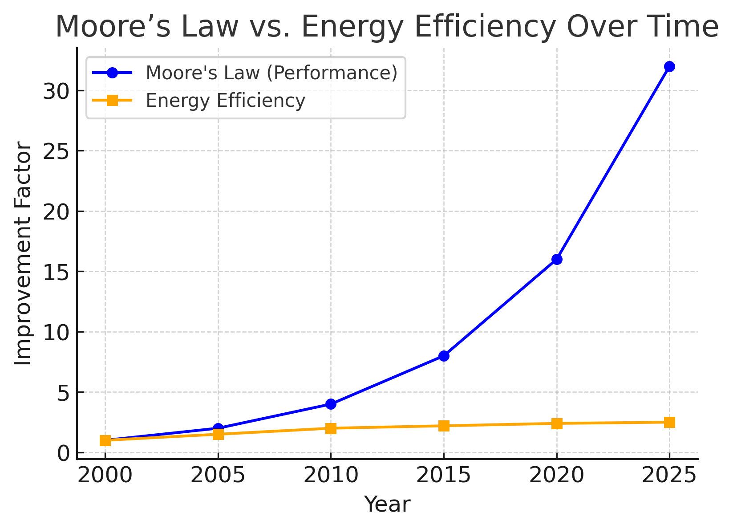
Moore’s Law vs. Energy Efficiency.
The Growing Gap
  Moore’s Law (computing power) improves exponentially.
  Energy efficiency has slowed significantly.
  Software inefficiency and AI workloads increase energy consumption.
Finally:
  Hardware gets faster, but not always greener.
  We need carbon-aware computing metrics.

Slide 33
What’s Next?
Research Directions in Sustainable Databases
Developing carbon-aware benchmarks for databases.
Investigating workload complexity vs. sustainability.
Analyzing AI’s impact on database server lifecycles.

Slide 34
The Case for Sustainable Computing
Frequent hardware upgrades are not always beneficial.
Databases must integrate sustainability into hardware planning.
New efficiency metrics should track CO₂ per transaction.
Longer hardware lifecycles are key to sustainable computing.
"Sustainable computing is not about the newest hardware—it’s about using what we have, efficiently."

Slide 35
Conclusion – A Case for Ecological Efficiency in Database Server Lifecycles
Frequent upgrades aren’t always greener
Location matters
Database workloads affect efficiency
Benchmarks should include carbon impact

