Slide 1
Goku: A Schemaless Time Series Database for Large Scale Monitoring at Pinterest
Monil Mukesh Sanghavi, Ming-May Hu, Zhenxiao Luo, Xiao Li, Kapil Bajaj​
Andreas Ioannou
Markos Fikardos

Slide 2
Table of contents
Background
Development Goals
System Architecture
Additional functionalities
Evaluation

Slide 3

What is Pinterest?

Slide 4
Need for a monitoring system
Monitor a growing collection of entities, spread across multiple availability zones.
Must be collected, stored, and queried to support identifying underperformance
Displaying graphs to help diagnosis

Slide 5


Original Systems behind Pinterest:
Initially used OpenTSDB and Hbase for system monitoring
OpenTSDB is Open-source, scalable, and built on top of Hbase

Slide 6
Insufficient systems
OpenTSDB and HBase scaled considerably and revealed several critical limitations, such as:
High Operation Costs
Performance Issues
Significant Maintenance Effort
Highlighted a need for a new system

Slide 7
Development goals behind Goku:
OpenTSDB feature parity to seamlessly integrate into the ex isting observability stack.
In-memory storage required for storing the last 24 hours of data
Secondary storage must be supported with data retention for up to 1 year, replacing OpenTSDB and Hbase
Support a high ingestion rate of millions of datapoints per second
Achieve p99 latency of 5seconds and 10 seconds respectively
Cost efficiency
Fault tollerance

Slide 8
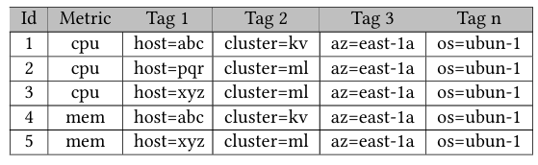
Data Model:
key-value pair, where the key comprises a metric name and multiple tag value pairs.
Tags provide additional context about the time series.
Goku is schemaless as the tags can be added anytime with no schema definitions needed beforehand.

Slide 9
QUERY MODEL
Goku uses Apache Thrift [24] for query RPC and responses, similar to OpenTSDB. Supports same query functionalities such as:
Metric Name And Tags
Time Range
Aggregation
Down-sampling
Rate Option
Filters
Notes:
: reduces data granularity by aggregating datapoints over larger intervals

Slide 10
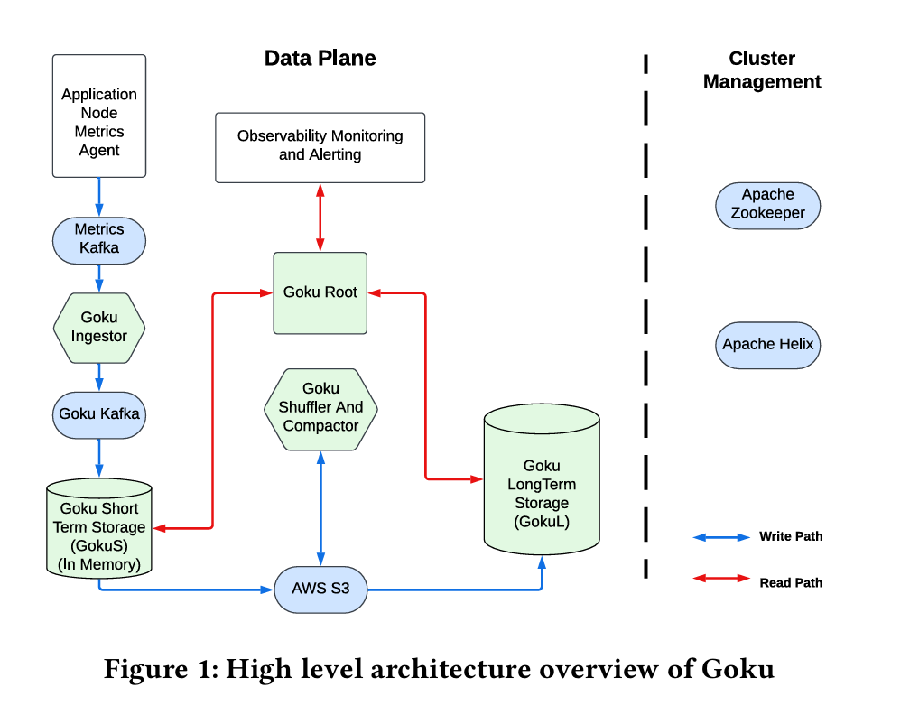
HIGH-LEVEL SYSTEM ARCHITECTURE

Slide 11
Components
Goku Short Term (GokuS)
Goku Long Term(GokuL)
Goku Ingestor
Goku Compactor & Shuffler
GokuRoot: a set of compute nodes that serve as a query end point for observability clients.

Slide 12
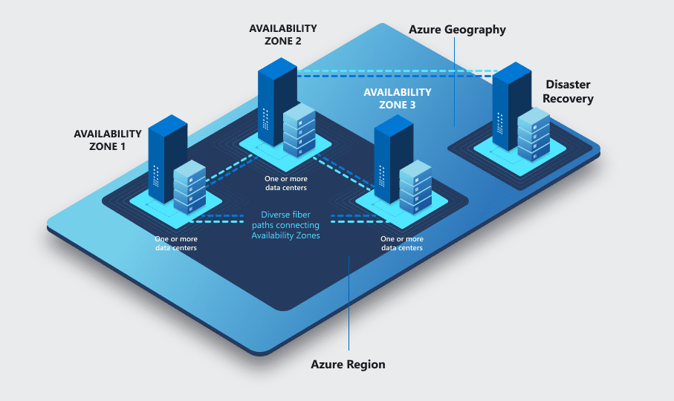
A cluster for each service
3 Replicas of GokuS and GokuL are maintained in different AZ
Each host (Congestor, Compactor) in different AZ
Each of these nodes operate in their own cluster

Slide 13
Benefits
Avoiding Noisy Neighbor Issues
Optimized Hardware Selection
Deployment AndRestarts

Slide 14
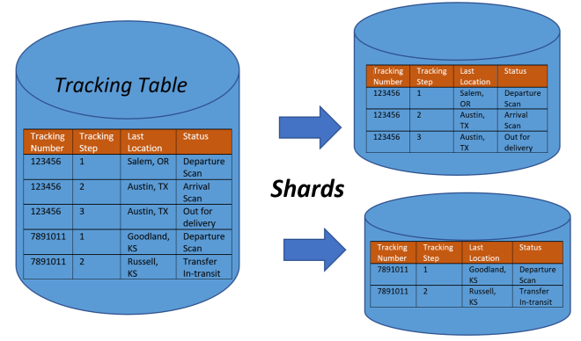
4.2 Sharding Scheme
Goku deploys a 2-layer hashing/sharding technique:
Shard-Group Assignment: First, the metric name of a time series is hashed to determine the shard-group.
Shard Assignment: Next, the full time series name(metricname + tag key-value pairs) is hashed to determine the specific shard within the shard-group.

Slide 15
Why use sharding?
Mitigating Noisy Neighbour Issues: The sharding strategy helps isolate the impact of spammy metrics which create spikes in the Goku resource usage and cause undefined behaviour.
Reduced Cross-AZ Failovers: The sharding scheme reduces the amount of cross-AZ failovers, which are typically discouraged due to their high latency and infrastructure costs.

Slide 16
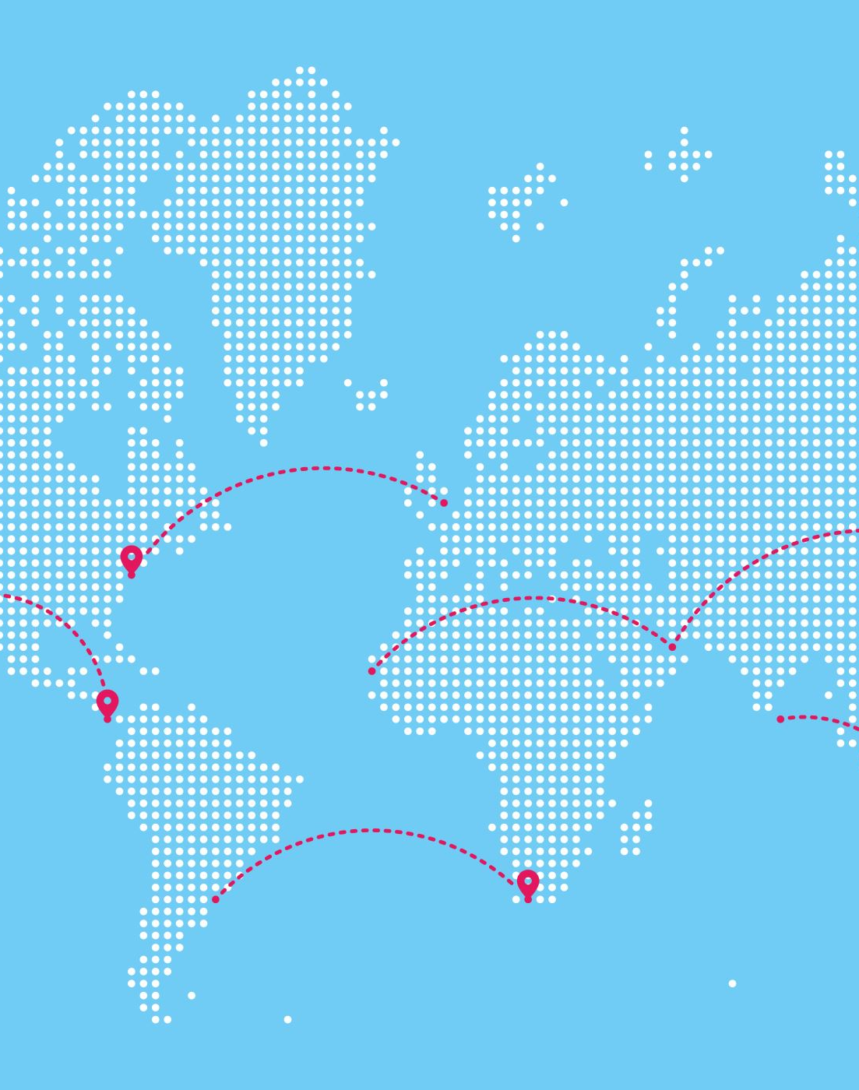
4.3 Cluster and Shard Management
Goku uses Apache Helix for clusters and Shard Management
Composed of Participants, Spectators, and Controller
Also uses Apache Zookeeper, to record views of these clusters,

Slide 17
4.4 Data Storage
Gorilla compression technique for compressing both its short-term in-memory data and long-term secondary storage data
Industry standard for Time series databases (InfluxDB [19], Prometheus [4], Uber’s M3DB[3], and Apache IOTDB [37])
Had to figure out amount of data to pack into a single Gorilla compressed stream

Slide 18
4.5 Tiering Strategy
Observations by developers show that the most common type of queries were the following:
Short-term Query: Query for Monitoring data in the past 24 hours to detect any prevalent issues
Long-term Query: Informative queries that search for data intervals of 1 month +

Slide 19
4.5 Tiering Strategy
Introduced “Tiers” of data
Tiers are defined as “partitions” of the whole dataset, which allows for configured bucket sizes, rollup strategy ect. For each individual tier
Rollup: Performed on data in GokuL (>24hours) in order to reduce the total number of datapoints. This in turn makes queries faster, with data accuracy loss being serviceable for the type of query.

Slide 20
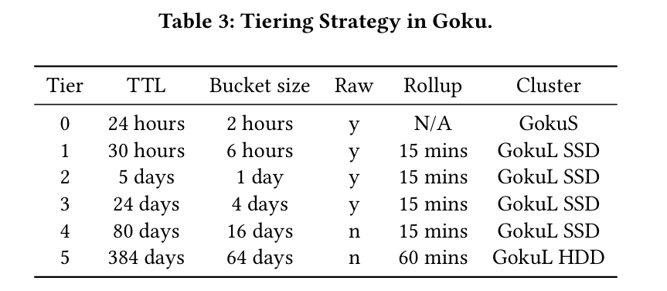
4.5 Tiering Strategy

Slide 21
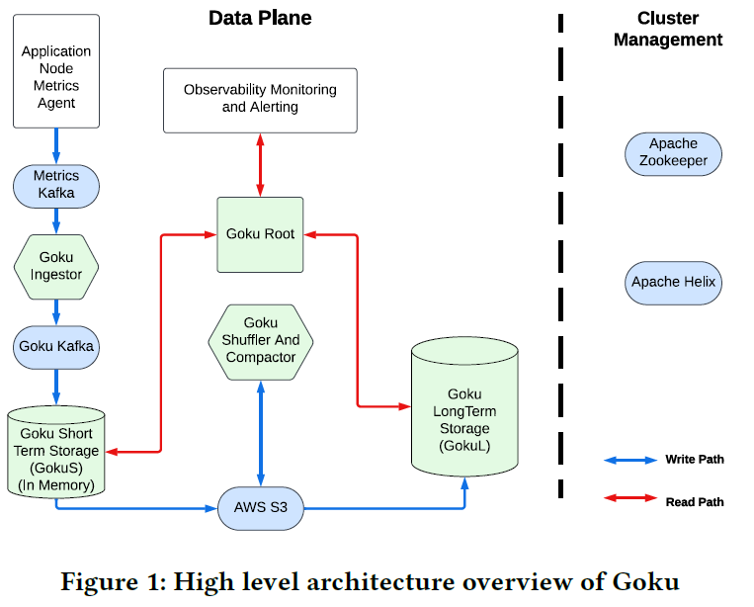
Write Path
Goku Ingestor
Goku Short Term Storage
Goku Shuffler and Compactor
Goku Long Term Storage
Notes:
Components

Slide 22
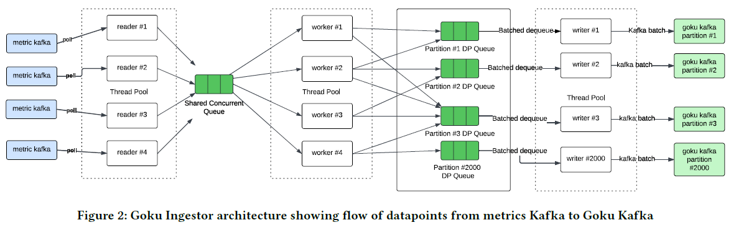
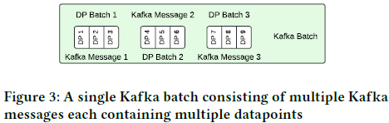
Goku Ingestor
Data Consumption:
  Consumption of datapoints from metrics Kafka.
  Storage in a shared in memory queue buffer.
Sharding Assignment:
  Datapoint selection from the shared queue.
  Determination of the target shard ID.
Batching Mechanism:
  Emptying of the queue of a partition assigned to it.
  Division to smaller lists of preconfigured batch size.
  Writing of each batch of datapoints as a single Kafka message.
  Production of the appropriate partition ID.
Notes:
The ingestion process has three stages: Data Consumption, Sharding Assignment and the Batching Mechanism.
1. From a reader thread pool the ingestor consumes datapoints from metrics Kafka and stores them in a shared in memory queue buffer.
2. From internal thread pool-based worker the datapoints are selected from the shared queue, and processed to determine the target shard ID
3. A schedule writer thread that runs every few milliseconds empties the queue of the assigned partition, divides it to smaller lists of a preconfigured batch size, writes a Kafka message that contains multiple datapoints and produces the appropriate partition ID

Slide 23
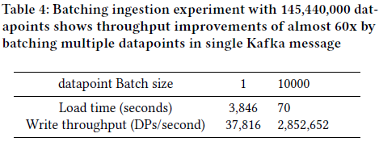
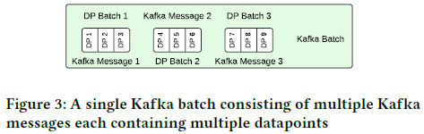
Experiment
Datapoints generated from TSBS with seed = 123 and scale = 1000
Batching at the application level in ingestor is more efficient.
Kafka handles fewer messages.
Network payload is minimized.
Notes:
Result:
Lower load time with batch size = 10000
Lower throughput with batch size = 1
(The lower throughput is caused by the increased number of non-payload bytes sent, due to the larger volume of individual Kafka messages, elevating the compression cost in the Kafka producer batching.)
2. ...because of the high volume of datapoints ingestions per minute.
3. With the local batching ...
4. ...because Kafka batching serves as an additional optimization

Slide 24
Fault Tolerance
Rebalancing and movement of the partition to a new consumer.
The Kafka offset is committed to the metrics Kafka brokers for the consumer by the Goku ingestor.
Messages can be redelivered to the new node.
Notes:
1. If Kafka detects that a consumer is not healthy or not consuming, it rebalance and moves the partition to a new consumer.
2. When Goku Kafka produces the data …
3. The new node resumes data consumption after partition rebalancing and …

Slide 25
Goku Short Term Storage (GokuS)
Can host multiple shards
Consumes metric datapoints for the shard id from the corresponding Kafka partition
Stores and serves the last 24 hours of data and support backfilling up to 2 hours.
Backfilling is the process of filling in the missing or the historical datapoints in a time series dataset
Notes:
The GokuS node

Slide 26
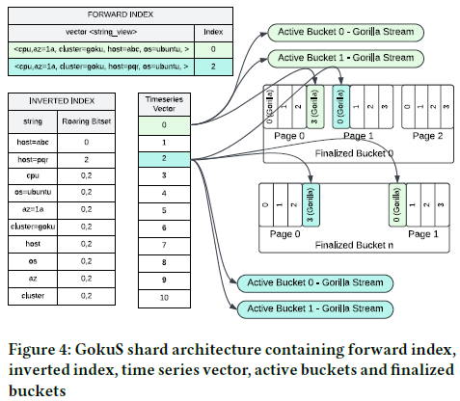
GokuS – Automatic Indexing
Every shard maintains a forward index.
  Key: full name , Value: index vector of time series objects
Employment of inverted index to facilitate query candidate selection.
  Each component in the full metric name is mapped to a list of time series vector indices.
Notes:
(Every time series in a shard is identified by its full name, consisting of components like metric name and tag set)
Figure 4
1. …the empty positions in the vector are maintained in a free list. GokuS picks an available index from the free list when it encounters a new time series, and adds it to the forward index
2. The list is stored using Roaring Bitmap and that enables efficient filtering by union and intersection operations

Slide 27
GokuS – Active Data Bucket
Each time series stores the most recent 4 hours of data in 2 active data buckets with cardinality of 2 hours each.
The active buckets support backfilling so datapoints are stored out of order.
Each active bucket contains a time series stream.
Data from active bucket are immutable after 4 hours.
Notes:
1. Each shards owns multiple time series
2. If we have two datapoints with the same timestamp the latest is used.
3. …that is a string that stores Gorilla encoded datapoints.
4. …this process is called finalization .

Slide 28
GokuS – Logging
Datapoints from active bucket time stream are asynchronously logged / appended to a log file on a disk.
Datapoints and their Kafka message offset are placed into a Multi – Producer, Multi – Consumer (MPMC) queue.
  Thread pool workers retrieve the datapoint and store it in a buffer.
  Datapoints and Kafka offset are batched and appended to the current log file when buffer reaches its pre - configured size.
Modified log files are uploaded to S3 every 10 minutes.
  Missing local log files are also uploaded to provide fault tolerance
Notes:
(The recovery routine will always seek the consumer to the latest Kafka offset recovered from the log file. In case of a hardware failure on a host between the time that a logfile is modified and is uploaded to S3, the owner of the shard will seek the Kafka offset that is recorded in the log file)

Slide 29
GokuS – Finalize Data Bucket
Finalized data bucket is created every 2 hours from the metrics data collected between 4 to 2 hours before.
The data become immutable and the Unix timestamp from 4 hours ago is used for the file name.
Every time series has a page index and page offset with the data location in the finalized bucket.
The finalize file is upload to S3.

Slide 30
GokuS – Recovery
Download of finalize bucket files and log files from S3.
Reading of the data into in – memory buffers.
Update of relevant page index and page offset.
Replay of log files to ensure that all updates are applied.
Seeking of the latest offset from the log files to ensure continuity in data ingestion and processing
Notes:
1. If the data are not available locally the shard recovery routine ..
2. Data from finalize bucket are read into in – memory buffers.
3. The time series …
4. The recovery routine starts to consume from the Kafka partition by ..

Slide 31
Goku Shuffler and Compactor
Reads bucket files from S3, reshards them and stores them back.
Marks shuffled bucket files.
Ensures fault tolerance if a shuffler host crashes and shards are managed by another shuffler.
Prepares data in GokuL storage format.
Merges the data from multiple smaller buckets for each bucket.
Creates indices.
Generates SST (Static Sorted Table) files.
Marks compacted files.
Notes:
Each time the shuffling routine runs, the shuffler checks for these markers. If any markers are missing, it schedules the shuffle utility for the unshuffled buckets.

Slide 32
Goku Long Term Storage (GokuL)
Stores long term metrics data.
Ingests the data prepared by the compactor from AWS S3.
Uses RockDB bulk ingestion API for SST ingestion of not ingested buckets.
Controls location of data with the local persistent storage of RockDB.
Storage nodes perform local aggregation of data.
Datapoints of each time series are store in Gorilla compressed metrics data in Rocks DB store.

Slide 33
Query Path
Goku Root
GokuS Health Monitoring
GokuS
GokuL
Pipelined And Thread Pool Based Query Execution

Slide 34
Goku Root
Query endpoint for observability alerting and web monitoring clients.
Cluster shard map monitor.
Query router to storage clusters.
Splits queries based on timer range.
Fanouts queries to the storage nodes.

Slide 35
GokuS Health Monitoring
Provides information about shards status to Goku Root.
  Based on this information the Goku Root decides to route a query to a shard in GokuS node or not.
  Provides fault tolerance in the query path.

Slide 36
GokuS
Tag value pair mapping to a list of time series ids.
Supports wildcard and regular expressions pattern matching query filter operations.
The finalize buckets provide a query for the most recent 4 hours of data.
The active buckets provide a query beyond the 4 hours.
Notes:
The inverted index of GokuS maps the tag value pair to a list of time series ids.

Slide 37
GokuL
Determination of the buckets that need to be queried.
Creation of dictionary keys.
Use of inverted index key for a list of time series ids.
Get data based on final list of time series.
Notes:
2. …to get the ids of the tag value pairs specified in the filters of the query
3. That list is shortened based on filters the data
4. After processing and aggregation, the data is returned to the root

Slide 38
Pipelined And Thread Pool Based Query Execution
Separated thread pools for fetching, decoding data and aggregation.
Parallel data fetching and operation computation by utilizing system resources.

Slide 39
5. Useful Feature Additions
These are some additional functionalities included by the developers of Goku.
One useful feature that has already been brought up is Rollup; which aggregates data to represent wider time intervals to reduce datapoints in GokuL (Long term storage)

Slide 40

5.1 Namespace
Goku had fixed set of properties for metric-storage.
Users and Clients would complain about not being able to change metric storage parameters to better suit their needs
Changing metric configurations would require host reboots

Slide 41
5.1 Namespace
Developers introduced namespace, which act as a logical configuration of a set of metric configurations and properties.
A metric belongs to only 1 given namespace, as they follow the configured properties of the associated namespace.
Namespace configurations are stored in a config file that all Goku hosts observe. If the contents are changed, then all hosts will be notified and parse the new changes.

Slide 42
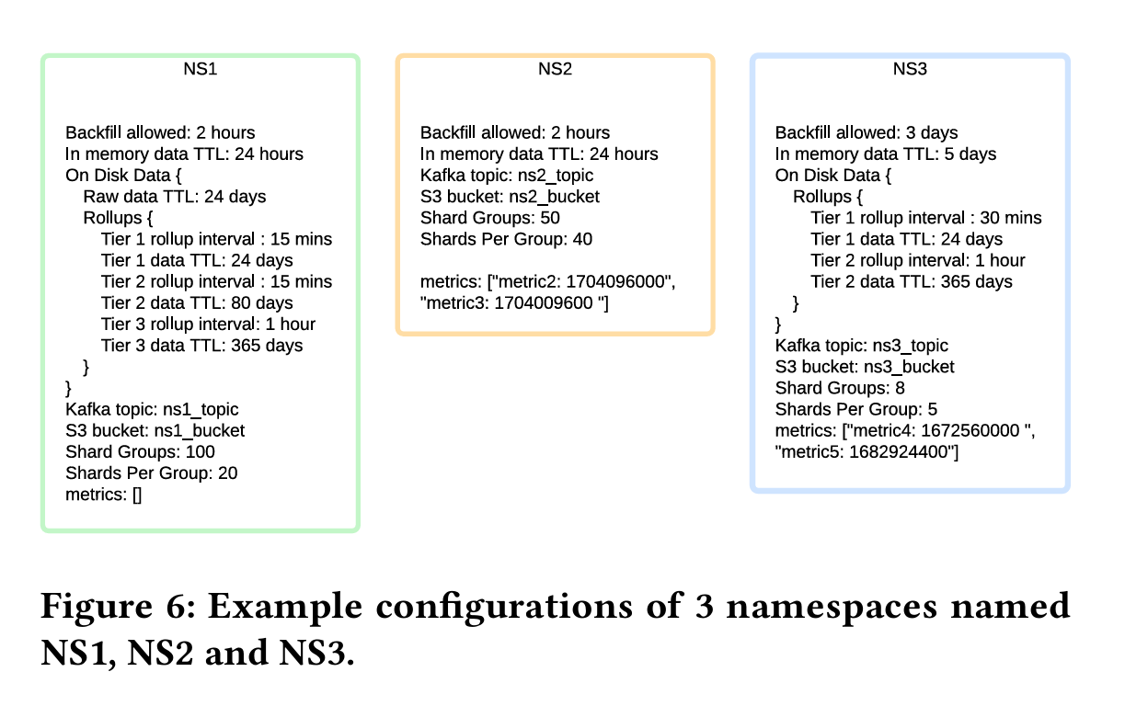

Slide 43
5.3 Pre-aggregation and Pagination
Pre-aggregation: Aggregate Time-series at write path, preserving key tags and grouping others. Greatly improves complex query execution
Pagination: Break large query results into manageable buckets, which reduces memory usage from wide wildcard queries

Slide 44
EVALUATION

Slide 45
7.1 In-production comparison with OpenTSDB+ HBase
High Operational Cost: using Gorilla compression, achieves more than 4x data storage at almost 0.5x the cost
Performance Issues: Optimized ingestion and query layers with better indexing, parallelized processing, and namespace-aware data layout, eliminating high query latencies, frequent timeouts, inefficient HBase scans, and memory overloads
Scalability Issues: Reduced strain on storage and improved consistency of scans and CPU Performance

Slide 46
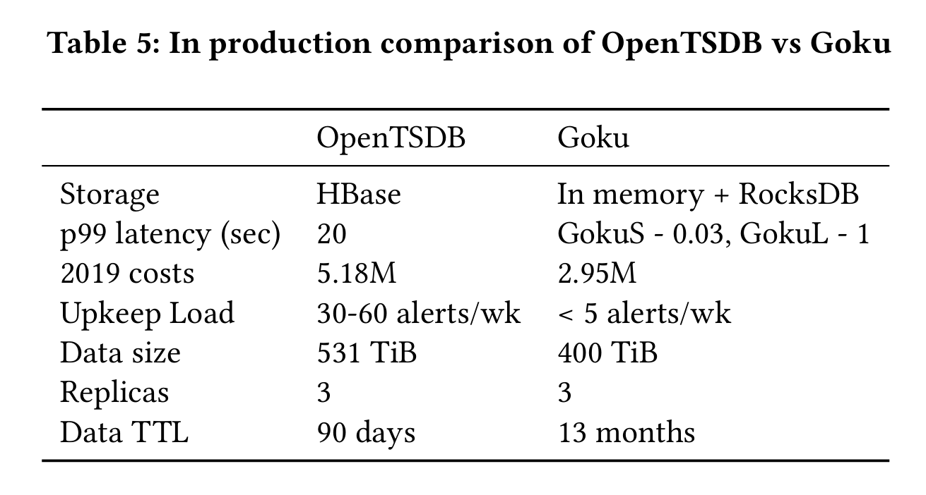
7.1 In-production comparison

Slide 47
Evaluation with other TSDBS
Test Environment
Write Benchmarking
Read Benchmarking

Slide 48
Test Environment
Addition of a client to TSBS benchmark.
  Generation and sending of data in OpenTSDB telnet format to an HTTP endpoint in Goku Ingestor.
  Batching of multiple datapoints in a single request body.
    Splitting of the request into multiple timeseries datapoints by the Goku Ingestor for further processing.
Generation of queries in OpenTSDB HTTP query format for the read path
  Routing of queries to Goku Root.
Generation of a 6-node cluster for Goku and a single-node for other TSDBs
Usage of Docker image from TSDBs’ websites.
Testing for high cardinality cases:
  For 1000 host scale, creating 101000 time series with145,44 million datapoints at 60 seconds intervals.
  For 100000 host scale, creating 10,1 million timeseries with 727,2 million datapoints at 20 minutes intervals.
Notes:
3. To ensure that the total resources for Goku matched those of the other TSDBs
4. To ran them as containers on the host

Slide 49
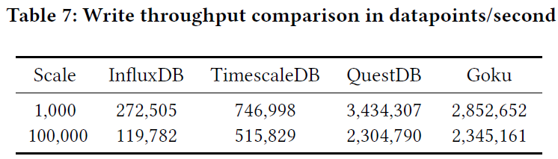
Write Benchmarking
Single worker writes data without flow control.
Recording of first and last Kafka message timestamp.
Write throughput = total number of datapoints / time difference of first and last Kafka message timestamp.
Goku has higher throughput in both cases than InfluxDB and TimeScaleDB and higher throughput from QuestDB for the second case.
Notes:
1. To ensure fairness and uniform client write rate a single worker writes the data without a flow control.
2. To determine the write rate, the authors recorded the first Kafka message timestamp created and appended to Kafka broker and the time of the last message written to the async log on the GokuS node.)
3. The correct write throughput is calculated by dividing the total number of datapoints ingested by the time difference between the Kafka messages timestamps
Results:
(InfluxDB ensures fault tolerance by fsyncing to the WAL file, guaranteeing data is written to disk. TimescaleDB, based on PostgreSQL prioritizes fault tolerance through atomic commits and disk writes, leading to reliable transactions
Goku, on the other hand, achieves fault tolerance by asynchronously logging the data along with the Kafka offset, thus maintaining high speed alongside reliability.
When scaling up data generation to 100,000 hosts, increasing cardinality by 100 times, QuestDB maintains a high write throughput similar to Goku due to its in-memory mapped region of a column file
TimescaleDB and InfluxDB, with their robust fault tolerance mechanisms, experience a performance shift, but continue to offer reliable data handling. Goku, with its asynchronous logging mechanism, consistently achieves robust performance and reliability.)

Slide 50
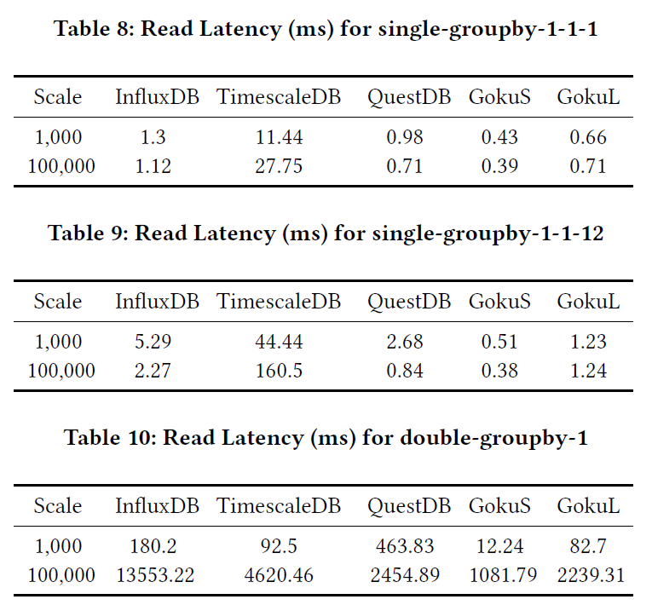
Read Benchmarking
Generation of 1000 queries for the two scales.
Three cases:
  Single-group by 1-1-1
  Single-group by 1-1-12
  Double-group by 1
Goku provides lower query latencies.
Notes:
Using the same seed as the write tests
Cases:
5-minute downsampled data with max aggregation for a single time series over 1 hour
Same as the first case but for 12 hours
1 hour downsampled data with average aggregation for all time series withing the metric over 1 day

Slide 51
Future Work
SQL Support
Snapshot GokuS Active Data To Disk For Faster Recovery
Read From AWS Object Store

Slide 52
Thank you for listening

